Slide 1
The AMD Branch (Mis)predictor
New Types and Methods of Straight-Line Speculation (SLS) Vulnerabilities
April 2022
hardwear.io webinar
Pawel Wieczorkiewicz
Open Source Security, Inc.

Slide 2
whoami
Pawel Wieczorkiewicz
Email: wipawel@grsecurity.net
Twitter: @wipawel
Security Researcher at Open Source Security, Inc. (creators of grsecurity®)
Low-level security research of system software and hardware
Reverse engineering and binary analysis
Kernel Test Framework (KTF) creator and maintainer
https://github.com/KernelTestFramework/ktf

Slide 3
Outline
Theory
Quick AMD microarchitecture overview
Branch predictors
Basic introduction
Purpose
Building blocks and functionality
Different types of branches
Straight-Line Speculation (SLS)
Basic introduction
Root cause mechanics
Types
Practice
CVE-2021-26341: a new unexpected type of SLS
Basic introduction
Speculation window and its limitations
SLS gadgets
Store-to-Load Forwarding (STLF)
Spectre v1: Fall-thru speculation of conditional branches
Bounds check latency related out-of-bound array access?
Branch predictor involvement
Speculation window and its limitations
SLS mitigations

Slide 4
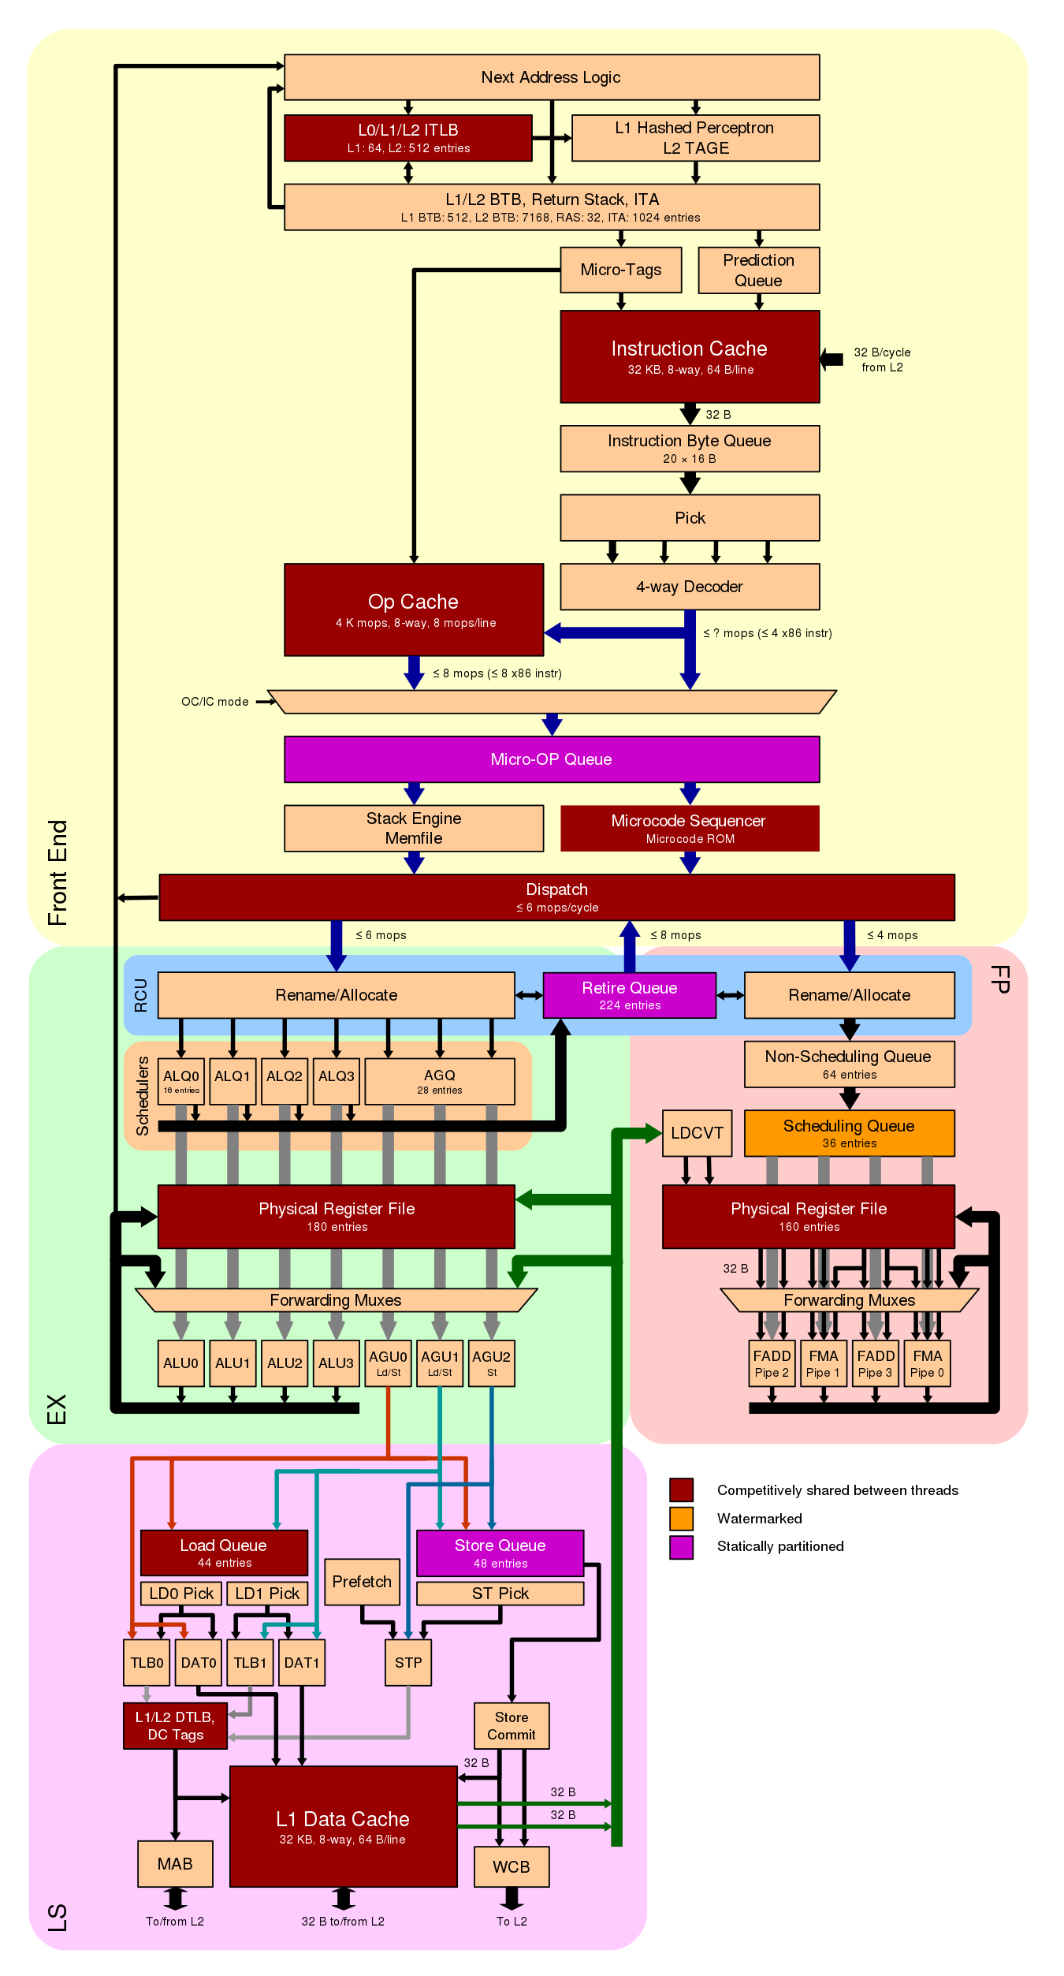
Microarchitecture - overview
AMD Zen2 microarchitecture
source: en.wikichip.org

Slide 5
Microarchitecture - overview
AMD Zen2 microarchitecture
Frontend
source: en.wikichip.org

Slide 6
Microarchitecture - overview
AMD Zen2 microarchitecture
Frontend
Fetch
source: en.wikichip.org

Slide 7
Microarchitecture - overview
AMD Zen2 microarchitecture
Frontend
Fetch
Decode
source: en.wikichip.org

Slide 8
Microarchitecture - overview
AMD Zen2 microarchitecture
Frontend
Fetch
Decode
Dispatch
source: en.wikichip.org

Slide 9
Microarchitecture - overview
AMD Zen2 microarchitecture
Backend
source: en.wikichip.org

Slide 10
Microarchitecture - overview
AMD Zen2 microarchitecture
Backend
Superscalar
source: en.wikichip.org

Slide 11
Microarchitecture - overview
AMD Zen2 microarchitecture
Backend
Superscalar
Out-of-order execution
source: en.wikichip.org

Slide 12
Microarchitecture - overview
AMD Zen2 microarchitecture
Backend
Superscalar
Out-of-order execution
In-order retire
source: en.wikichip.org

Slide 13
Microarchitecture - overview
AMD Zen2 microarchitecture
Frontend
Fetch
Decode
Dispatch
Backend
Superscalar
Out-of-order execution
In-order retire
Frontend
Backend
source: en.wikichip.org

Slide 14
Microarchitecture - overview
AMD Zen2 microarchitecture
Frontend
Fetch
Decode
Dispatch
Backend
Superscalar
Out-of-order execution
In-order retire
Frontend
Backend
source: en.wikichip.org

Slide 15
Microarchitecture - overview
AMD Zen2 microarchitecture
Frontend
Fetch
Decode
Dispatch
Backend
Superscalar
Out-of-order execution
In-order retire
Frontend
Backend
source: en.wikichip.org

Slide 16
Branch predictors - purpose
Why do we need the branch prediction unit (BPU)?
Backend of modern superscalar and out-of-order CPUs can have many instructions “in-flight”
Frontend must keep up supplying instructions to the Backend
Any feedback from Backend to Frontend will stall the CPU
Must be avoided
Some definitive information available only in the Backend
Frontend must predict the likely outcome upfront
Correct prediction ➔ performance win
Misprediction ➔ penalty, Frontend re-steer when Backend detects
The better (more accurate) prediction rate, the better performance (fewer bubbles)
Frontend needs to know where to find next instructions to fetch and decode
Easy for sequential execution ➔ next instruction
Problematic upon control flow change (branch)
Two questions:
IF – taken or not taken
Where-to – address of the next instruction

Slide 17
Branch predictors - design and building blocks
Branch Prediction Unit (BPU)
Many different designs and categories
Static vs Dynamic
One-Level vs Two-level
Local vs Global
Adaptive
Agree
Hybrid
Neural (Machine Learning)
Perceptron-based (AMD Zen2)

Slide 18
Branch predictors - design and building blocks
Branch Prediction Unit (BPU)
Many different designs and categories
Static vs Dynamic
One-Level vs Two-level
Local vs Global
Adaptive
Agree
Hybrid
Neural (Machine Learning)
Perceptron-based (AMD Zen2)
Prediction based on the actual branch instruction and a pre-defined heuristic:
Type of branch
Conditional
Unconditional
Branch direction
Forward
Backward
Examples:
Unconditional branches are always taken
Backward branches taken (loops accuracy)
Forward branches not taken
Unconditional branches are easier to predict than conditional

Slide 19
Branch predictors - design and building blocks
Branch Prediction Unit (BPU)
Many different designs and categories
Static vs Dynamic
One-Level vs Two-level
Local vs Global
Adaptive
Agree
Hybrid
Neural (Machine Learning)
Perceptron-based (AMD Zen2)
Prediction based on previous execution results of a given branch
If taken before, likely to be taken again

Slide 20
Branch predictors - design and building blocks
Branch Prediction Unit (BPU)
Many different designs and categories
Static vs Dynamic
One-Level vs Two-level
Local vs Global
Adaptive
Agree
Hybrid
Neural (Machine Learning)
Perceptron-based (AMD Zen2)
Prediction based on previous executions results of a given branch
If taken before, likely to be taken again
1-bit saturation counter
Previously taken or not taken

Slide 21
Branch predictors - design and building blocks
Branch Prediction Unit (BPU)
Many different designs and categories
Static vs Dynamic
One-Level vs Two-level
Local vs Global
Adaptive
Agree
Hybrid
Neural (Machine Learning)
Perceptron-based (AMD Zen2)
Prediction based on previous executions results of a given branch
If taken before, likely to be taken again
1-bit saturation counter
Previously taken or not taken
2-bit saturation counter
Four states state machine

Slide 22
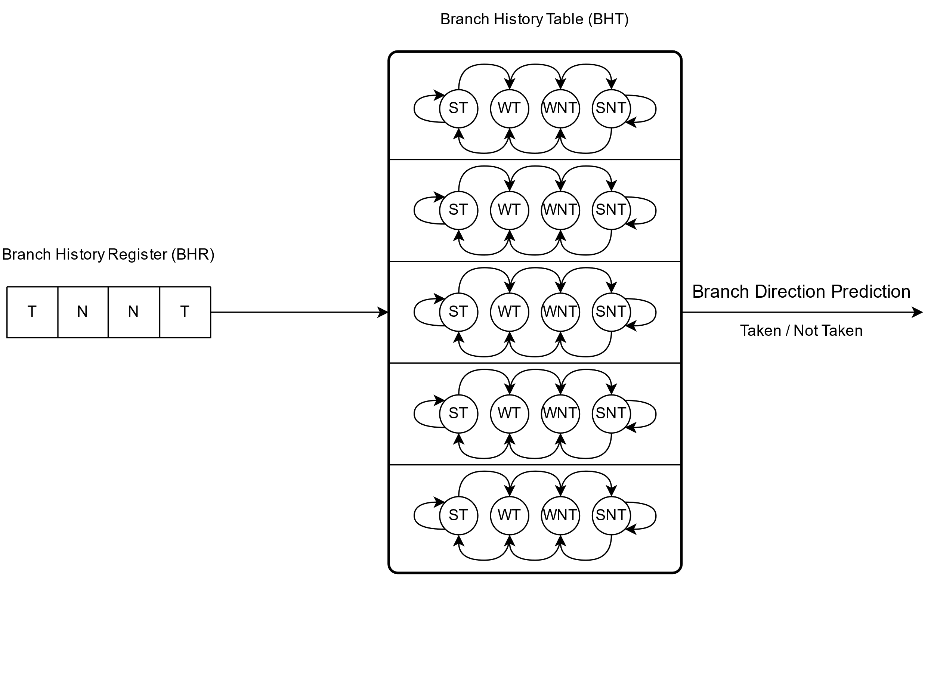
Branch predictors - design and building blocks
Branch Prediction Unit (BPU)
Many different designs and categories
Static vs Dynamic
One-Level vs Two-level
Local vs Global
Adaptive
Agree
Hybrid
Neural (Machine Learning)
Perceptron-based (AMD Zen2)
Prediction is based on a two-dimensional table of 2-bit saturation counters (Branch/Pattern History Table) indexed with branch history register

Slide 23
Branch predictors - design and building blocks
Branch Prediction Unit (BPU)
Many different designs and categories
Static vs Dynamic
One-Level vs Two-level
Local vs Global
Adaptive
Agree
Hybrid
Neural (Machine Learning)
Perceptron-based (AMD Zen2)
Branch History Table is indexed using a distinct branch history register for each encountered conditional branch

Slide 24
Branch predictors - design and building blocks
Branch Prediction Unit (BPU)
Many different designs and categories
Static vs Dynamic
One-Level vs Two-level
Local vs Global
Adaptive
Agree
Hybrid
Neural (Machine Learning)
Perceptron-based (AMD Zen2)
Branch History Table is indexed using a distinct branch history register for each encountered conditional branch
Branch History Table is indexed using a shared (global) branch history register for all encountered conditional branches
Correlation between different branches is considered
May harm prediction accuracy when too many branches are not correlated

Slide 25
Branch predictors - design and building blocks
Branch Prediction Unit (BPU)
Many different designs and categories
Static vs Dynamic
One-Level vs Two-level
Local vs Global
Adaptive
Agree
Hybrid
Neural (Machine Learning)
Perceptron-based (AMD Zen2)
gshare – Two-level adaptive predictor with global history buffer
Program Counter
Branch History Table (BHT)
ST
WT
WNT
SNT
ST
WT
WNT
SNT
ST
WT
WNT
SNT
Branch Direction Prediction
Taken / Not Taken
ST
WT
WNT
SNT
Global History Register (GHR)
ST
WT
WNT
SNT
T
T
N
T
N
N
T
N
T
N

Slide 26
Branch predictors - design and building blocks
Branch Prediction Unit (BPU)
Many different designs and categories
Static vs Dynamic
One-Level vs Two-level
Local vs Global
Adaptive
Agree
Hybrid
Neural (Machine Learning)
Perceptron-based (AMD Zen2)
Consists of multiple different branch prediction mechanisms
Prediction is based on:
Prediction mechanism that has had highest accuracy in the past
Combined output of all implemented prediction mechanisms

Slide 27
Branch predictors - design and building blocks
So far, we have been implicitly focusing on direct conditional branch predictions
Taken / Not taken
Question: IF at all

Slide 28
Branch predictors - design and building blocks
So far, we have been implicitly focusing on direct conditional branch predictions
Taken / Not taken
Question: IF at all
What about other branch types?
Do they need a branch predictor too?

Slide 29
Branch predictors - design and building blocks
So far, we have been implicitly focusing on direct conditional branch predictions
Taken / Not taken
Question: IF at all
What about other branch types?
Do they need a branch predictor too?
Yes, they do!
Question: Where-to

Slide 30
Branch predictors - design and building blocks
Branch Target Buffer (BTB)
So far, we have been implicitly focusing on direct conditional branch predictions
Taken / Not taken
Question: IF branch at all
What about other branch types?
Do they need a branch predictor too?
Yes, they do!
Question: Where-to
Another important BPU component:
Branch Target Buffer (BTB)
Branch Target Address 1
Branch Target Address 2
Branch Target Address 3
...
Branch Target Address N
Target Address Prediction

Slide 31
Branch predictors – branch target buffer
Branch Target Buffer (BTB)
Predicts address of next instructions after the control flow changes because of a branch
Turns out: ALL branch types need BTB!
Frontend fetches and decodes, but does not execute instructions
Frontend needs to know where to fetch next instructions from upon a branch
It must not wait for Backend
Performance!
Hence, BPU is a Frontend’s component and leverages BTB to steer Frontend upon branches
Branch Target Address 1
Branch Target Address 2
Branch Target Address 3
...
Branch Target Address N
Target Address Prediction

Slide 32
Branch predictors – branch target buffer
Branch Target Buffer (BTB)
Analyzing branch instructions addressing is backend’s job
Where-To problem:
Direct conditional branches:
Not taken ➔ next instruction
easy
Taken ➔ where-to?
backward, forward, not easy
Direct unconditional branches:
Always taken ➔ where?
backward, forward, not easy
Indirect unconditional branches:
Always taken ➔ where?
backward, forward, not easy
Target address may change at runtime, not static
static prediction will not do
BTB is crucial for performance
Branch Target Address 1
Branch Target Address 2
Branch Target Address 3
...
Branch Target Address N
Target Address Prediction

Slide 33
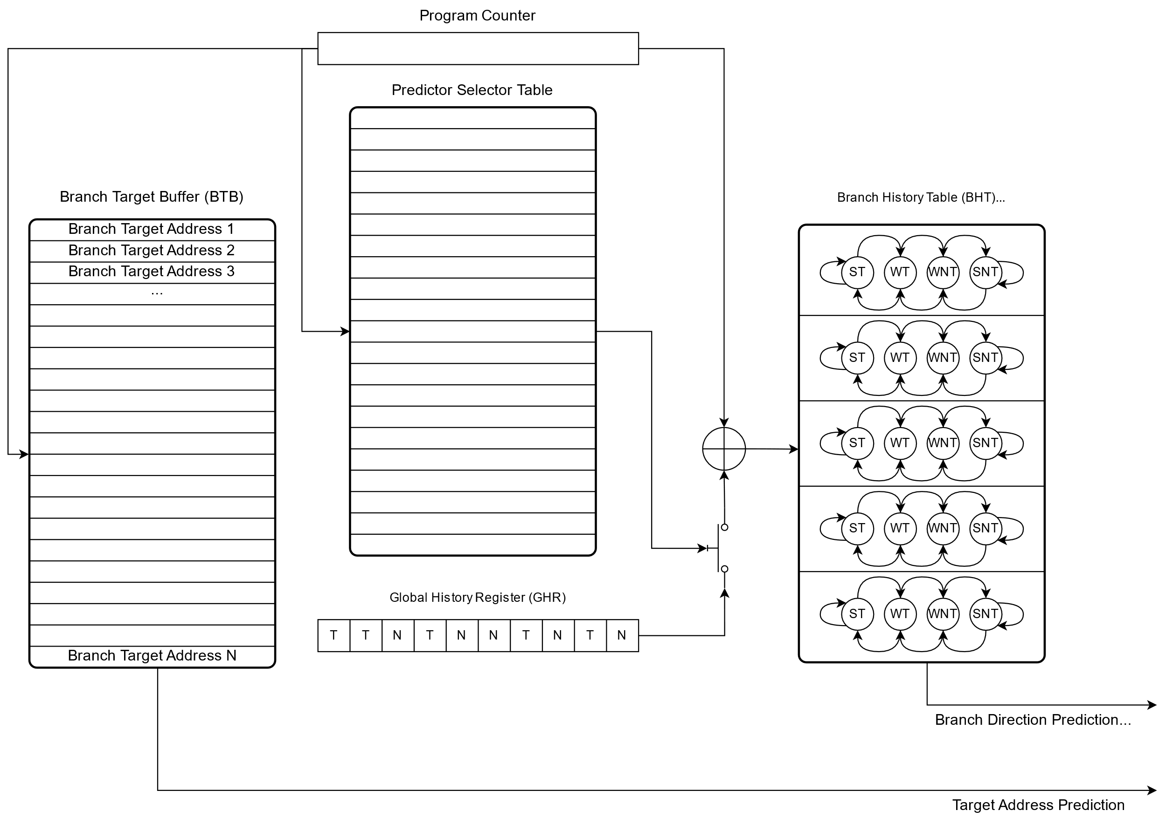
Hybrid branch predictor – example

Slide 34
Hybrid branch predictor – building blocks
Answer: IF

Slide 35
Hybrid branch predictor – building blocks
Answer: Where-to

Slide 36
Branch predictors – different types of branches
Direct
Conditional
Jumps
Taken
Not Taken
Unconditional
Jumps
Calls
Indirect
Unconditional
Jumps
Calls
Function return

Slide 37
Branch predictors – different types of branches
Direct
Conditional
Jumps
Taken
Not Taken
Unconditional
Jumps
Calls
Indirect
Unconditional
Jumps
Calls
Function return
x86: Jcc $address
Control flow change to the specified $address, when condition is met
Condition cc is based on the state of the status flags (EFLAGS register)
JA – jump if above
Status flags: CF=0 and ZF=0
JB – jump if below
Status flags: CF=1
JE – jump if equal
Status flags: ZF=1
JNE – jump if not equal
Status flags: ZF=0

Slide 38
Branch predictors – different types of branches
Direct
Conditional
Jumps
Taken
Not Taken
Unconditional
Jumps
Calls
Indirect
Unconditional
Jumps
Calls
Function return
Example (Taken)
a = 0 if (a == 0)
*addr = %rax
else
%rax = *addr
xor %rdi, %rdi ; set ZF=1 test %rdi, %rdi ; set ZF=1
je END_LABEL ; if ZF==1 goto END_LABEL mov (%rsi), %rax ; memory load END_LABEL:
mov %rax, (%rsi) ; memory store

Slide 39
Branch predictors – different types of branches
Direct
Conditional
Jumps
Taken
Not Taken
Unconditional
Jumps
Calls
Indirect
Unconditional
Jumps
Calls
Function return
Example (Not Taken)
a = 1 if (a == 0)
*addr = %rax
else
%rax = *addr
mov $1, %rdi
test %rdi, %rdi ; set ZF=0 je END_LABEL ; if ZF==1 goto END_LABEL mov (%rsi), %rax ; memory load END_LABEL:
mov %rax, (%rsi) ; memory store

Slide 40
Branch predictors – different types of branches
Direct
Conditional
Jumps
Taken
Not Taken
Unconditional
Jumps
Calls
Indirect
Unconditional
Jumps
Calls
Function return
x86: JMP $address
Unconditional control flow change to the specified $address, without return
Direct – target address static
Part of the instruction
Used by compilers to implement:
Loops
Tail calls
Sharing common code blocks
Error handling code
…
Other uses:
RAP – jumping over meta-data in code
Live patching
…

Slide 41
Branch predictors – different types of branches
Direct
Conditional
Jumps
Taken
Not Taken
Unconditional
Jumps
Calls
Indirect
Unconditional
Jumps
Calls
Function return
x86: CALL $address
Unconditional control flow change to the specified $address with return
Direct – target address static
Part of the instruction
CALL instruction ➔ push %rip; jmp $address
Execution flow is expected to resume at the CALL following instruction eventually
Used by compilers to implement:
Procedure calls
Recursive calls
…
Other uses:
__x86.get_pc_thunk.* – position independent code execution helper on i386/i686
…

Slide 42
Branch predictors – different types of branches
Direct
Conditional
Jumps
Taken
Not Taken
Unconditional
Jumps
Calls
Indirect
Unconditional
Jumps
Calls
Function return
x86: JMP reg (or [mem])
Unconditional control flow change to the dynamic address specified via register or memory dereference, without return
Indirect – target address dynamic
May change at runtime
Specified by register or memory location
i386: absolute address
x64: pc-relative offset
Used by compilers to implement:
Tail calls
Jump tables
Switch-case
Virtual function tables (C++)
Multiway conditional branches

Slide 43
Branch predictors – different types of branches
Direct
Conditional
Jumps
Taken
Not Taken
Unconditional
Jumps
Calls
Indirect
Unconditional
Jumps
Calls
Function return
x86: CALL reg (or [mem])
Unconditional control flow change to the dynamic address specified via register or memory dereference, with return
Indirect – target address dynamic
May change at runtime
Specified by register or memory location
i386: absolute address
x64: pc-relative offset
Used by compilers to implement:
Function pointers
Virtual functions (C++)
Position independent code

Slide 44
Branch predictors – different types of branches
Direct
Conditional
Jumps
Taken
Not Taken
Unconditional
Jumps
Calls
Indirect
Unconditional
Jumps
Calls
Function return
x86: RET
Unconditional control flow change to the $address located on stack
Indirect – target address dynamic
May change at runtime
Stored on stack upon function call
Used by compilers to implement:
Function returns
Retpoline
Does not use BTB, but Return Stack Buffer (RSB) aka Return Address Stack (RAS)

Slide 45
Straight-Line Speculation (SLS)
Straight-Line Speculation term was coined by Arm
result of Google SafeSide project research - CVE-2020-13844
Arm described SLS as a speculative execution past an unconditional change in the control flow: "Straight-line speculation would involve the processor speculatively executing the next instructions linearly in memory past the unconditional change in control flow“
Initially observed on indirect unconditional branches on Arm CPUs
Shortly after, the SLS was also observed on “some x86 CPUs”
Also, on indirect unconditional branches
However:
SLS had to have been observed on x86 CPUs prior to Arm coining the term
Appearance of traps after RET instructions:
~2018: Microsoft Windows
~2019: grsecurity®

Slide 46
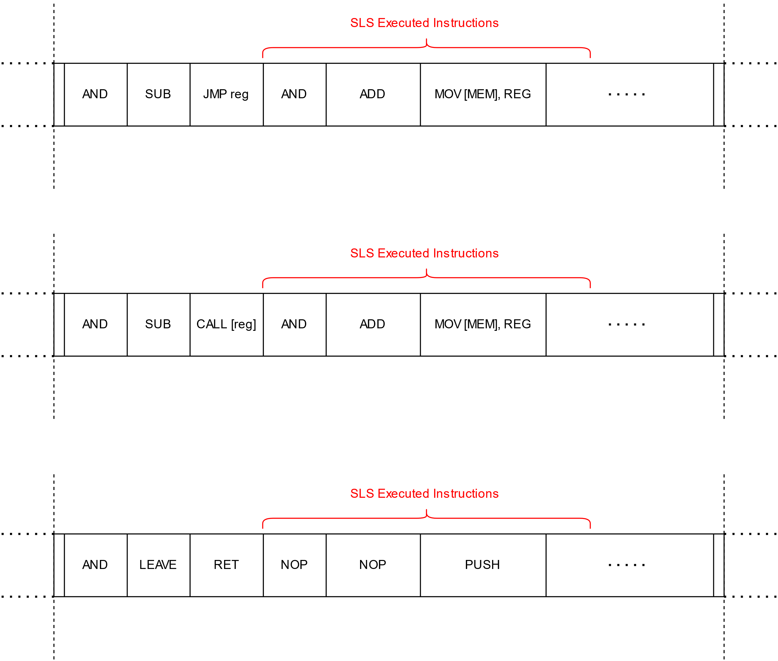
Straight-Line Speculation (SLS)
Types of SLS
Indirect
Unconditional
Jump and Call
JMP/CALL reg
JMP/CALL [mem]
Function return
RET

Slide 47
Straight-Line Speculation (SLS)
Types of SLS
Indirect
Unconditional
Jump and Call
JMP/CALL reg
JMP/CALL [mem]
Function return
RET
What about direct branches?

Slide 48
CVE-2021-26341 - Direct unconditional branch SLS
AMD x86 CPUs (Zen1 and Zen2 microarchitectures)
All direct unconditional branch instructions experience SLS vulnerability too!
JMP $address
CALL $address
Branch direction does not matter
Forward and backward branches suffer from the SLS
It is possible to trigger the SLS between two co-located hyper-threads
AMD x86 CPU (Zen3 microarchitecture)
SLS on direct unconditional branches seems to be fixed
Big design upgrade of the branch predictor unit
Intentional or accidental?

Slide 49
CVE-2021-26341 - Direct unconditional branch SLS
SLS code example
; memory address 0 whose access latency allows to observe the speculative execution
0. mov CACHE_LINE_0_ADDR, %rsi
; memory address 1 whose access latency allows to observe the speculative execution
1. mov CACHE_LINE_1_ADDR, %rbx
; flush both cache lines out of cache hierarchy to get a clean state
2. clflush (%rsi)
3. clflush (%rbx)
4. mfence
5. jmp END_LABEL
; memory load to the flushed cache line; it never executes architecturally
6. mov (%rsi / %rbx), %rax
7. END_LABEL:
8. measure CACHE_LINE_0/1_ADDR access time

Slide 50
Straight-Line Speculation (SLS)
Why would a modern CPU speculate past a direct unconditional branch?
After all:
Its target address is static!
And encoded as part of the instruction!
There is no latency involved
Its unconditional – no need to evaluate conditions

Slide 51
Straight-Line Speculation (SLS)
Why would a modern CPU speculate past a direct unconditional branch?
After all:
Its target address is static!
And encoded as part of the instruction!
There is no latency involved
Its unconditional – no need to evaluate conditions
Let’s see why…

Slide 52
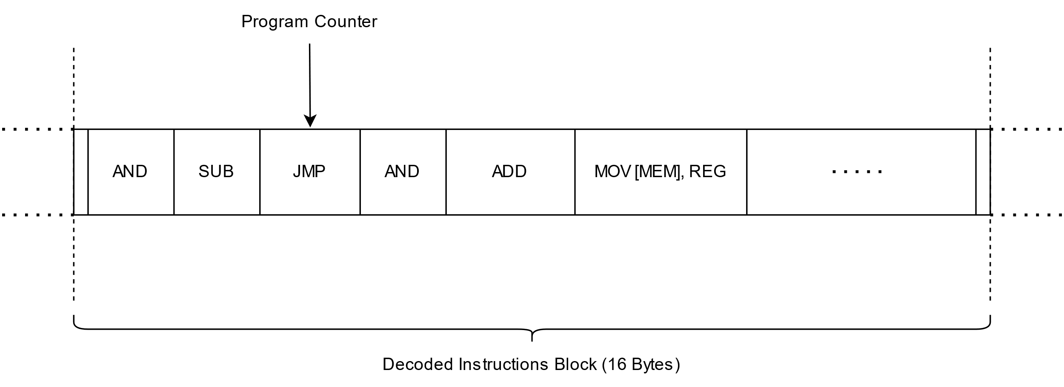
Straight-Line Speculation (SLS) - mechanics

Slide 53
Straight-Line Speculation (SLS) - mechanics
Branch

Slide 54
Straight-Line Speculation (SLS) - mechanics
Branch Target Buffer
Branch

Slide 55
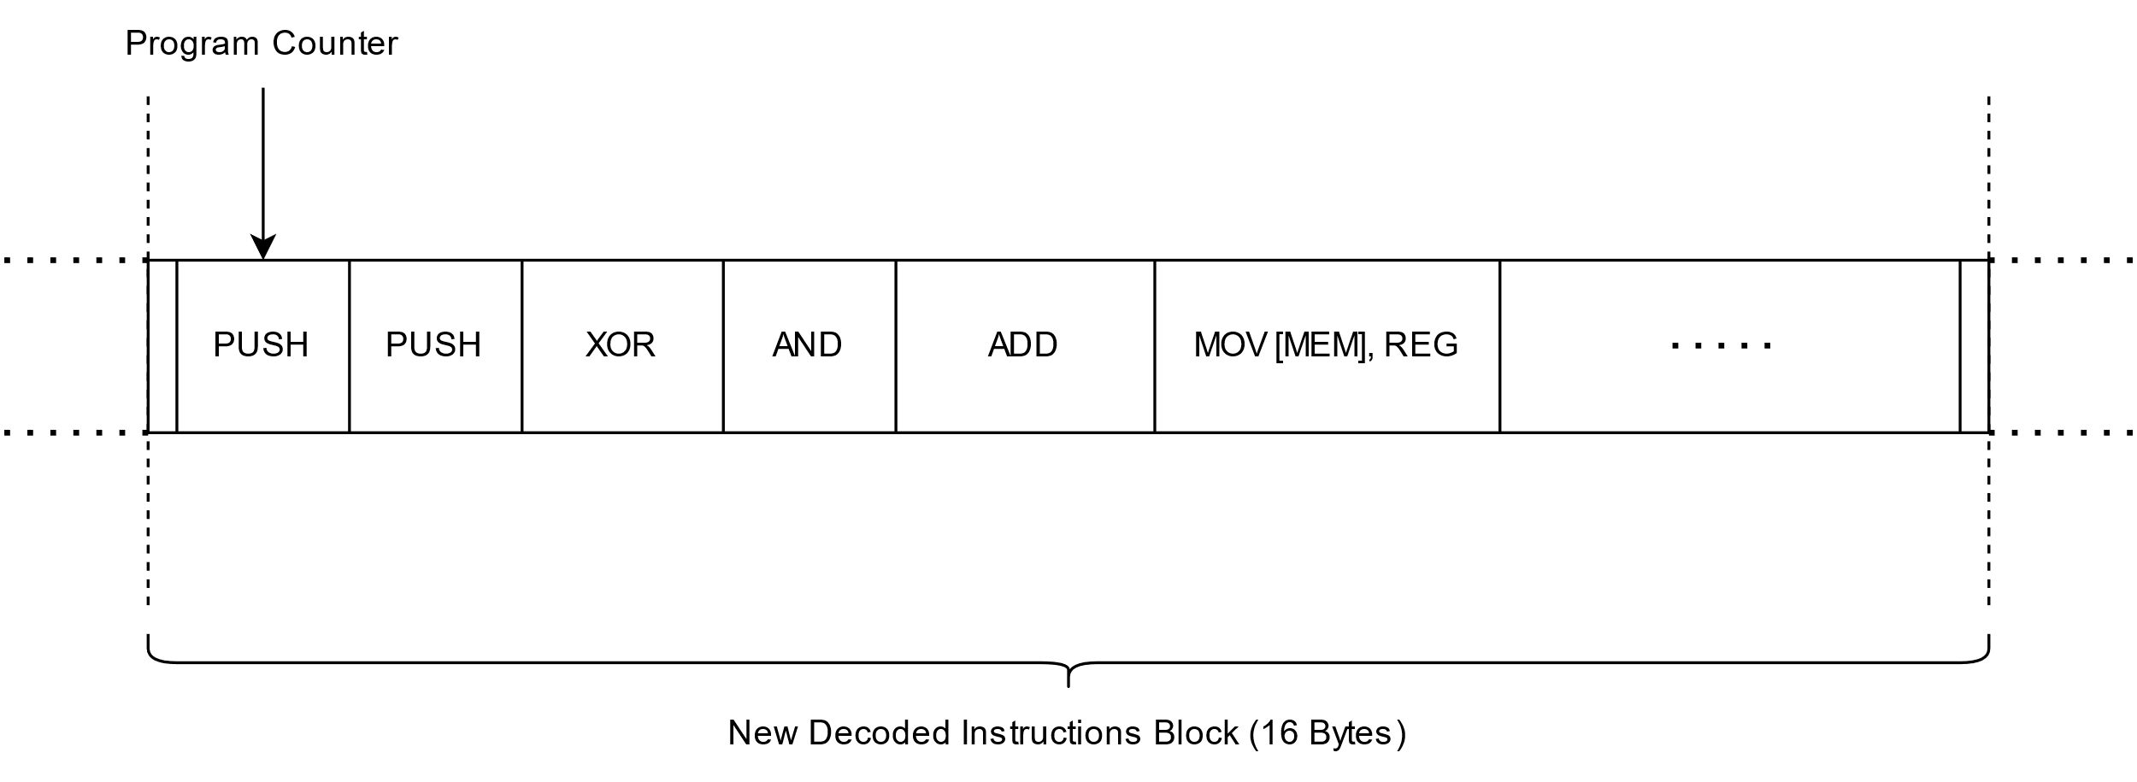
Straight-Line Speculation (SLS) - mechanics
Jump target address
Predicted correctly

Slide 56
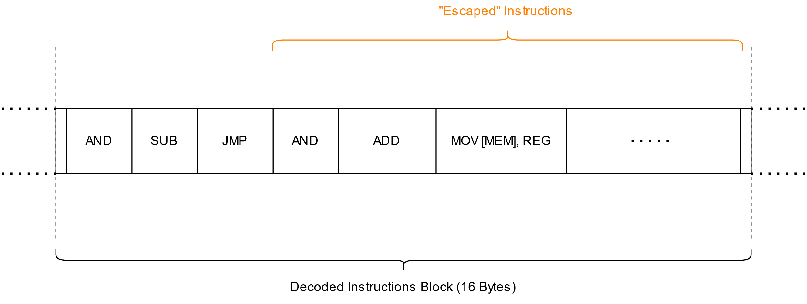
Straight-Line Speculation (SLS) - mechanics
Mispredicted

Slide 57
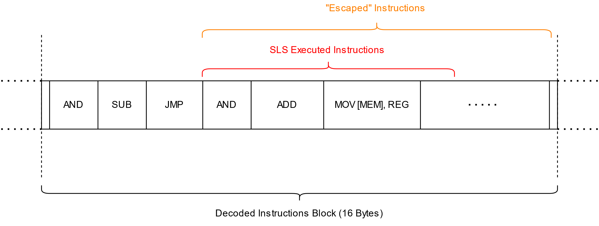
Straight-Line Speculation (SLS) - mechanics

Slide 58
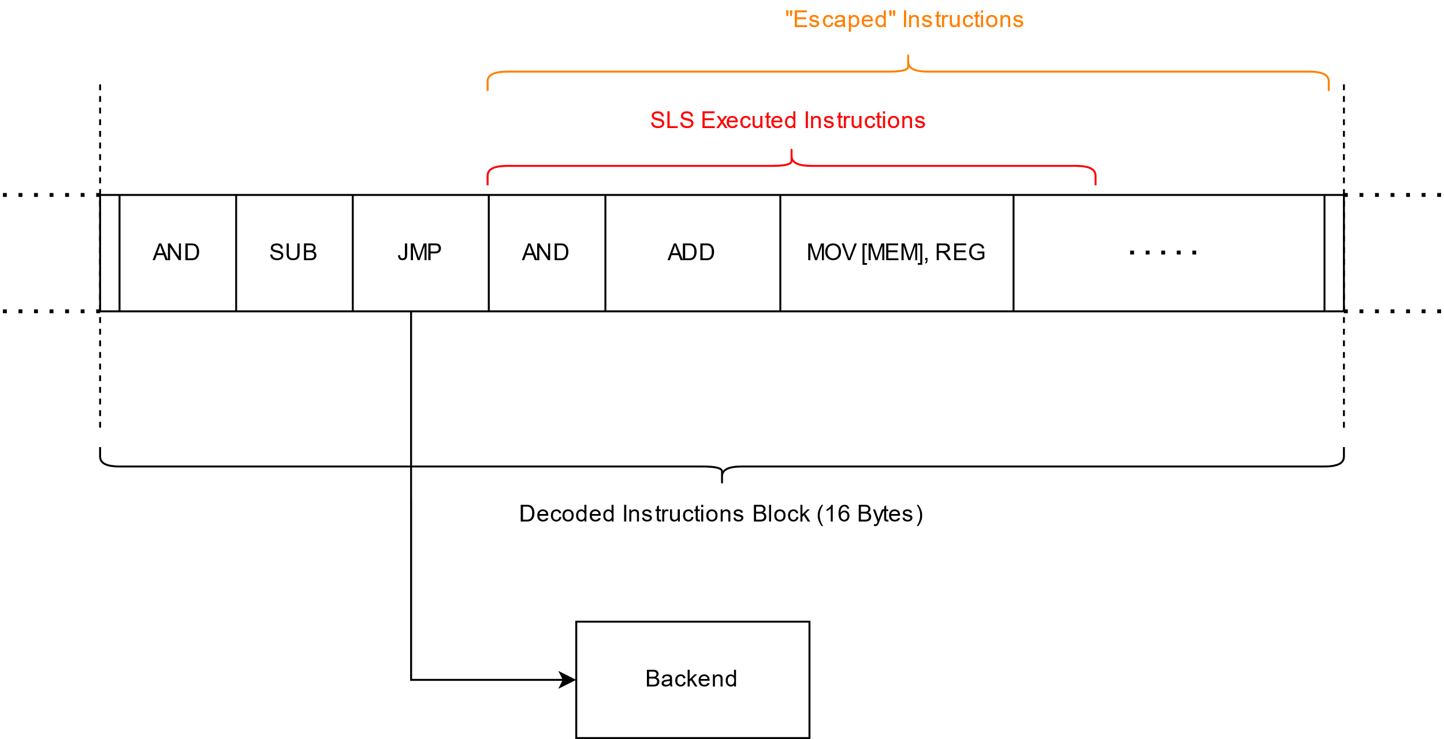
Straight-Line Speculation (SLS) - mechanics

Slide 59
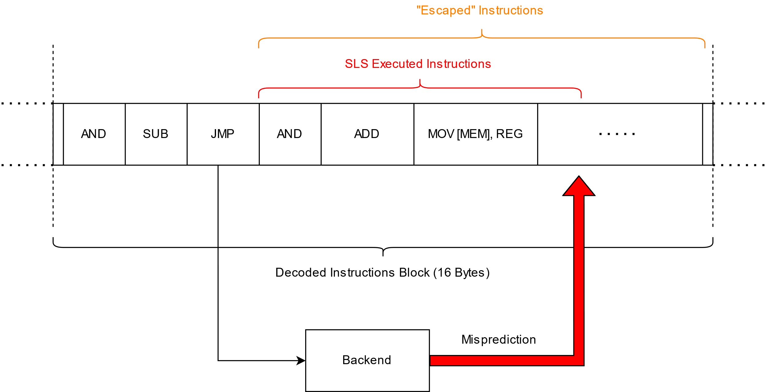
Straight-Line Speculation (SLS) - mechanics

Slide 60
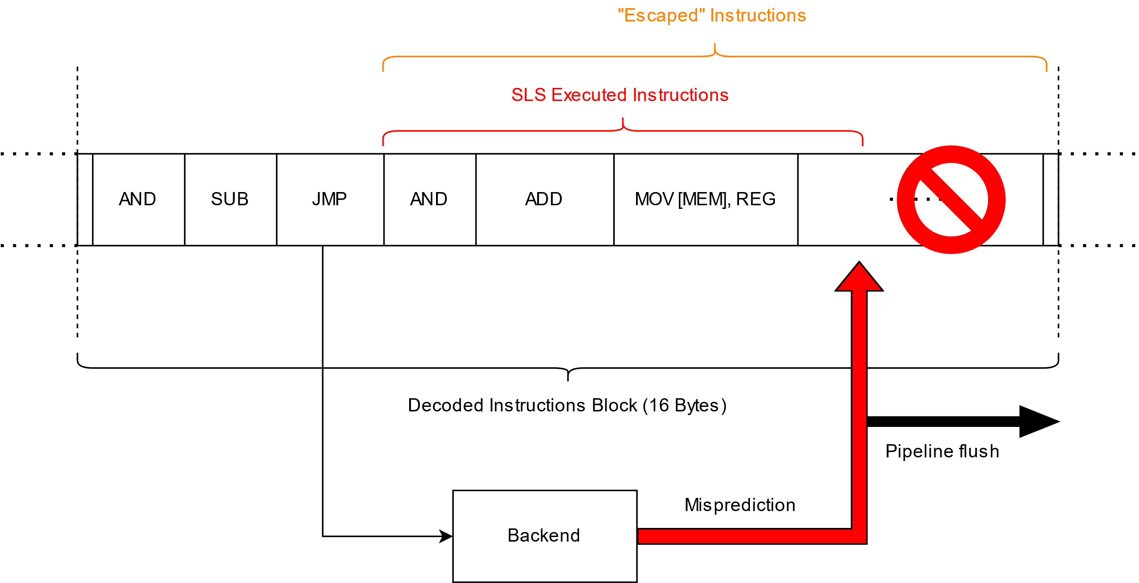
Straight-Line Speculation (SLS) - mechanics

Slide 61
CVE-2021-26341 - Direct unconditional branch SLS
If there is no entry in the BTB (or Return Address Stack (RAS) for RET instructions)
the branch will be mispredicted and SLS might occur
Any branch type!
What does it mean?
we can easily and almost 100% reliably make affected AMD CPUs mispredict any branch …
Direct or indirect
Conditional or unconditional
… and trigger SLS past it.
How?
We need to make sure the corresponding BTB entry is not present
Simplest way: flushing entire BTB

Slide 62
CVE-2021-26341 - Direct unconditional branch SLS
Flushing entire BTB
Execute a large enough number of the consecutive branches
Each will take at least one entry in the BTB
BTB entries can hold up to two branches within the same 64-byte instruction block
Provided the first branch is a conditional branch
Solution
Place two unconditional branches within a single cache-line
Upon execution at least one entry of the BTB will be taken
Repeat this code construct a NUMBER of times
Entire BTB overwritten if the NUMBER is equal to or greater than the number of entries of the given BTB
.macro flush_btb NUMBER
; start at a cache-line size aligned address
.align 64
; repeat the code between .rept and .endr
; directives a NUMBER of times
.rept \NUMBER
jmp 1f ; first unconditional jump
.rept 30 ; half-cache-line-size padding
nop
.endr
1: jmp 2f ; second unconditional jump
.rept 29 ; full cache-line-size padding
nop
.endr
2: nop
.endr
.endm

Slide 63
CVE-2021-26341 - Direct unconditional branch SLS
Speculation window
up to 8 simple and short (up to 16 bytes) x86 instructions can be speculatively executed
in practice: 4-5 short x86 instructions that do not compete for execution units
up to 2 memory loads can be executed speculatively
the loads (even pre-cached) cannot provide data to the following uops in time
the loads do get scheduled and can leave traces in cache hierarchy
Limitations
constructing a full Spectre v1 gadget is not possible with this type of SLS
Secret data needs to be available in GPR (registers) for the SLS gadget
or…

Slide 64
CVE-2021-26341 - Direct unconditional branch SLS
Store-To-Load-Forwarding (STLF)
Forwarding data of a completed (but not yet retired) stores to the later loads
Stores are buffered in the Store Queue (WAW and WAR dependencies)
Later loads must get fresh data either from the Store Queue (if fresh) or memory
Memory loads executed under SLS receive data from the earlier stores to the same address
STLF enables speculative loads under SLS to execute fast
Such loads do provide data to their dependent uops
STLF requirements
Earlier store contains all the load’s bytes (cannot load more)
CPU uses address bits 11:0 to determine STLF eligibility
Same address space and ideally same registers, closely grouped together
Notes:
WAW – Write after write
i1. R2 <- R4 + R7
i2. R2 <- R1 + R3
i2 tries to write an operand before it is written by i1
WAR – Write after read
i1. R4 <- R1 + R5
i2. R5 <- R1 + R2
i2 tries to write a destination before it is read by i1

Slide 65
CVE-2021-26341 - Direct unconditional branch SLS
SLS gadget example
asm goto (
"mov $0x4141414141414141, %%rbx\n“
"mov %%rbx, (%0)\n“
"sfence\n“
"lfence\n“
".align 64\n“
"jmp %l[end]\n“
"mov (%0), %%rbx\n“
"and %1, %%rbx\n“
"add %2, %%rbx\n“
"mov (%%rbx), %%ebx\n“
:: "r" (&path), "r" (1UL << bufsiz), "r" (buf)
: "rbx", "memory“
: end);
end:

Slide 66
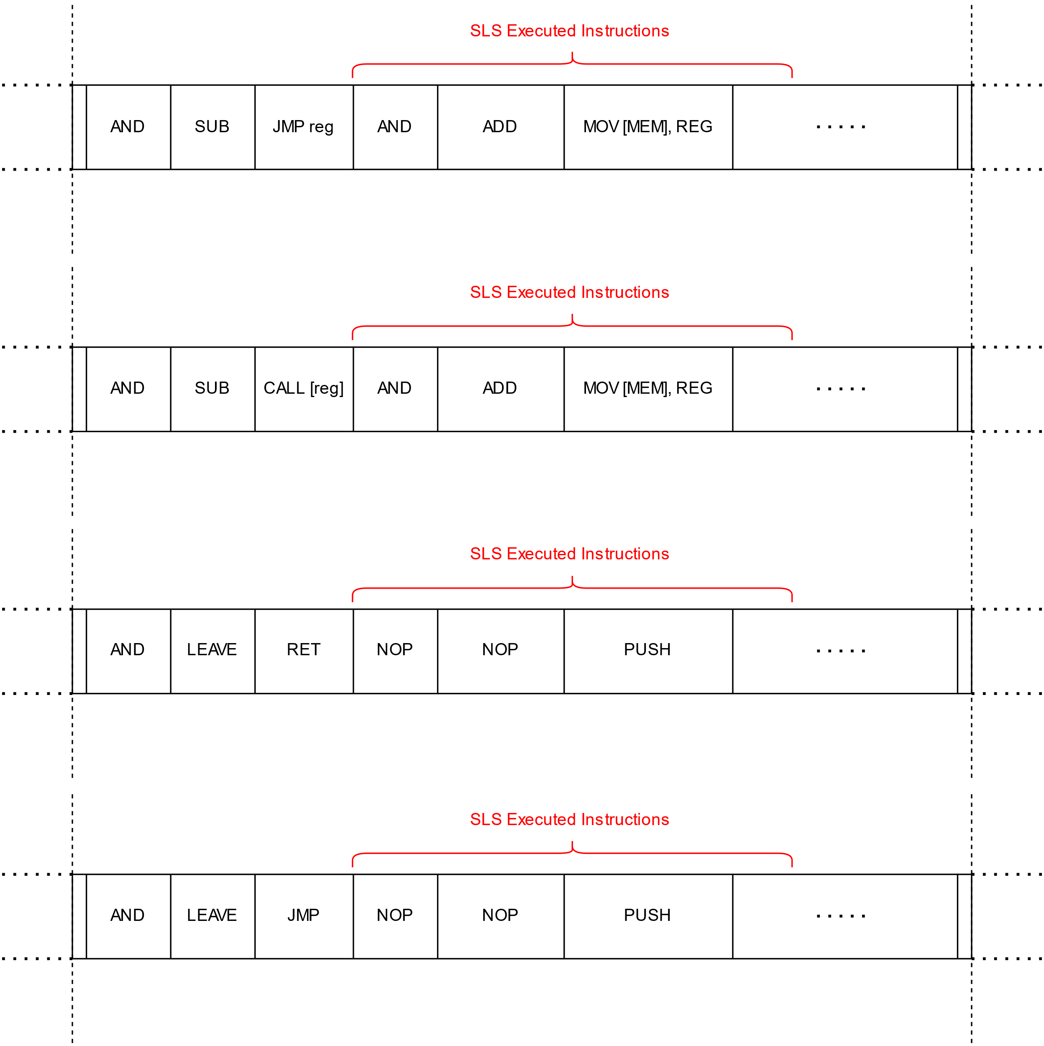
Straight-Line Speculation (SLS)
Types of SLS
Indirect
Unconditional
Jump and Call
JMP/CALL reg
JMP/CALL [mem]
Function return
RET
Direct
Unconditional
Jump and Call
JMP/CALL $address

Slide 67
Straight-Line Speculation (SLS)
Types of SLS
Indirect
Unconditional
Jump and Call
JMP/CALL reg
JMP/CALL [mem]
Function return
RET
Direct
Unconditional
Jump and Call
JMP/CALL $address
What about direct conditional branches?

Slide 68
Speculation of conditional branches
Both paths of conditional branches (taken or not taken) are architecturally legitimate
Hence, there is no direct conditional branch SLS
Rather, we speak of a branch fall-through speculation
If a conditional branch is architecturally taken
It could be speculatively executed as not taken ➔ mispredicted
Typical Spectre v1 situation

Slide 69
Spectre v1: a fall-thru speculation of conditional branches
Spectre v1 and conditional branches relation
A common Spectre v1 gadget
Out-of-bound array access
Speculative bypass of a bound check
Bound check memory access latency
Most speculation blocking mitigation target “array-based” Spectre v1 gadgets
But, is Spectre v1 really limited to that?

Slide 70
Spectre v1: a fall-thru speculation of conditional branches
Flush BTB to trigger a fall-thru speculation for a conditional branch
No condition evaluation considerations necessary
No memory access (or any other) latency required
Easy to make any conditional branch mispredict
Even a trivial one
Speculative type confusion
No need for array out-of-bound
Works also on AMD Zen3!
Neither this nor direct unconditional branch SLS affects Intel

Slide 71
Spectre v1: a fall-thru speculation of conditional branches
Gadget example
; memory address whose access latency allows to observe the mispredictions
0. mov $CACHE_LINE_ADDR, %rsi
; flush the cache line out of cache hierarchy to get a clean state
1. clflush (%rsi)
2. mfence
3. xor %rdi, %rdi ; set ZF=1
4. jz END_LABEL ; if ZF==1 goto END_LABEL
; memory load to the flushed cache line; it never executes architecturally
5. mov (%rsi), %rax
6. END_LABEL:
7. measure CACHE_LINE_ADDR access time

Slide 72
Spectre v1: a fall-thru speculation of conditional branches
Speculation window
Noticeably shorter than “regular” Spectre v1 speculation window
up to 8 simple and short (up to 16 bytes) x86 instructions can be speculatively executed
in practice: ~5-7 short x86 instructions that do not compete for execution units
up to 2 memory loads can be executed speculatively
the loads (must be pre-cached) do provide data to the following uops in time
Constructing a full Spectre v1 gadget is possible
Secret data can be anywhere in memory
Limitations
Shorter speculation window ➔ fewer instructions
More difficult to build cache oracle

Slide 73
SLS Mitigations
Here we discuss SLS mitigation for the following branches:
Direct unconditional jump
Indirect unconditional jump
Function return RET
These three cases are easy to mitigate
Just put a speculative execution barrier (i.e., serializing or ordering instruction) after
The shorter the instruction the better
Never gets executed architecturally
SLS mitigation for direct and indirect unconditional call is not that simple
At some point control flow resumes execution at an instruction following the call
The speculative execution barrier gets executed architecturally
Must not have architectural “side-effects”

Slide 74
SLS Mitigations
Mitigation for
Direct unconditional jump
Indirect unconditional jump
Function return RET
INT3 – single byte opcode (0xCC)

Slide 75
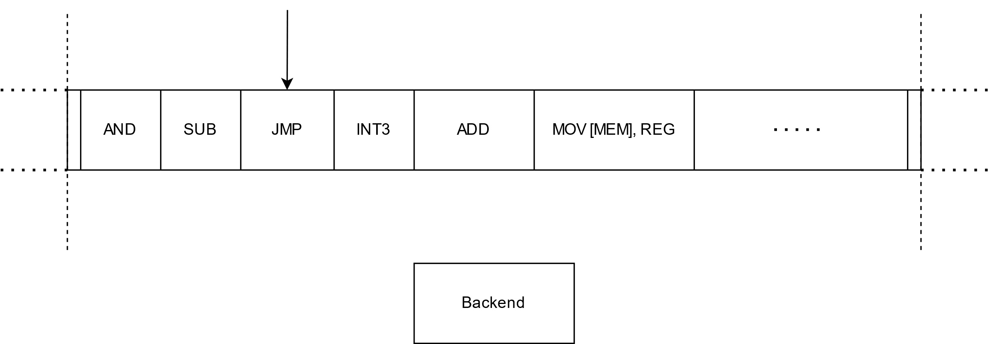
SLS Mitigations

Slide 76
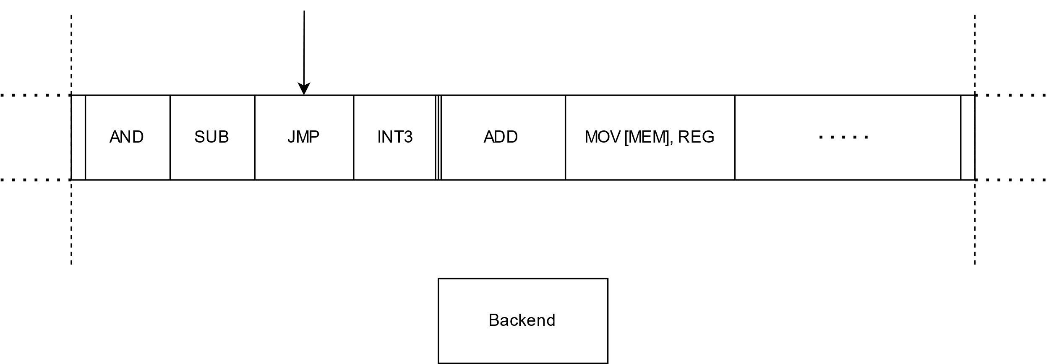
SLS Mitigations

Slide 77
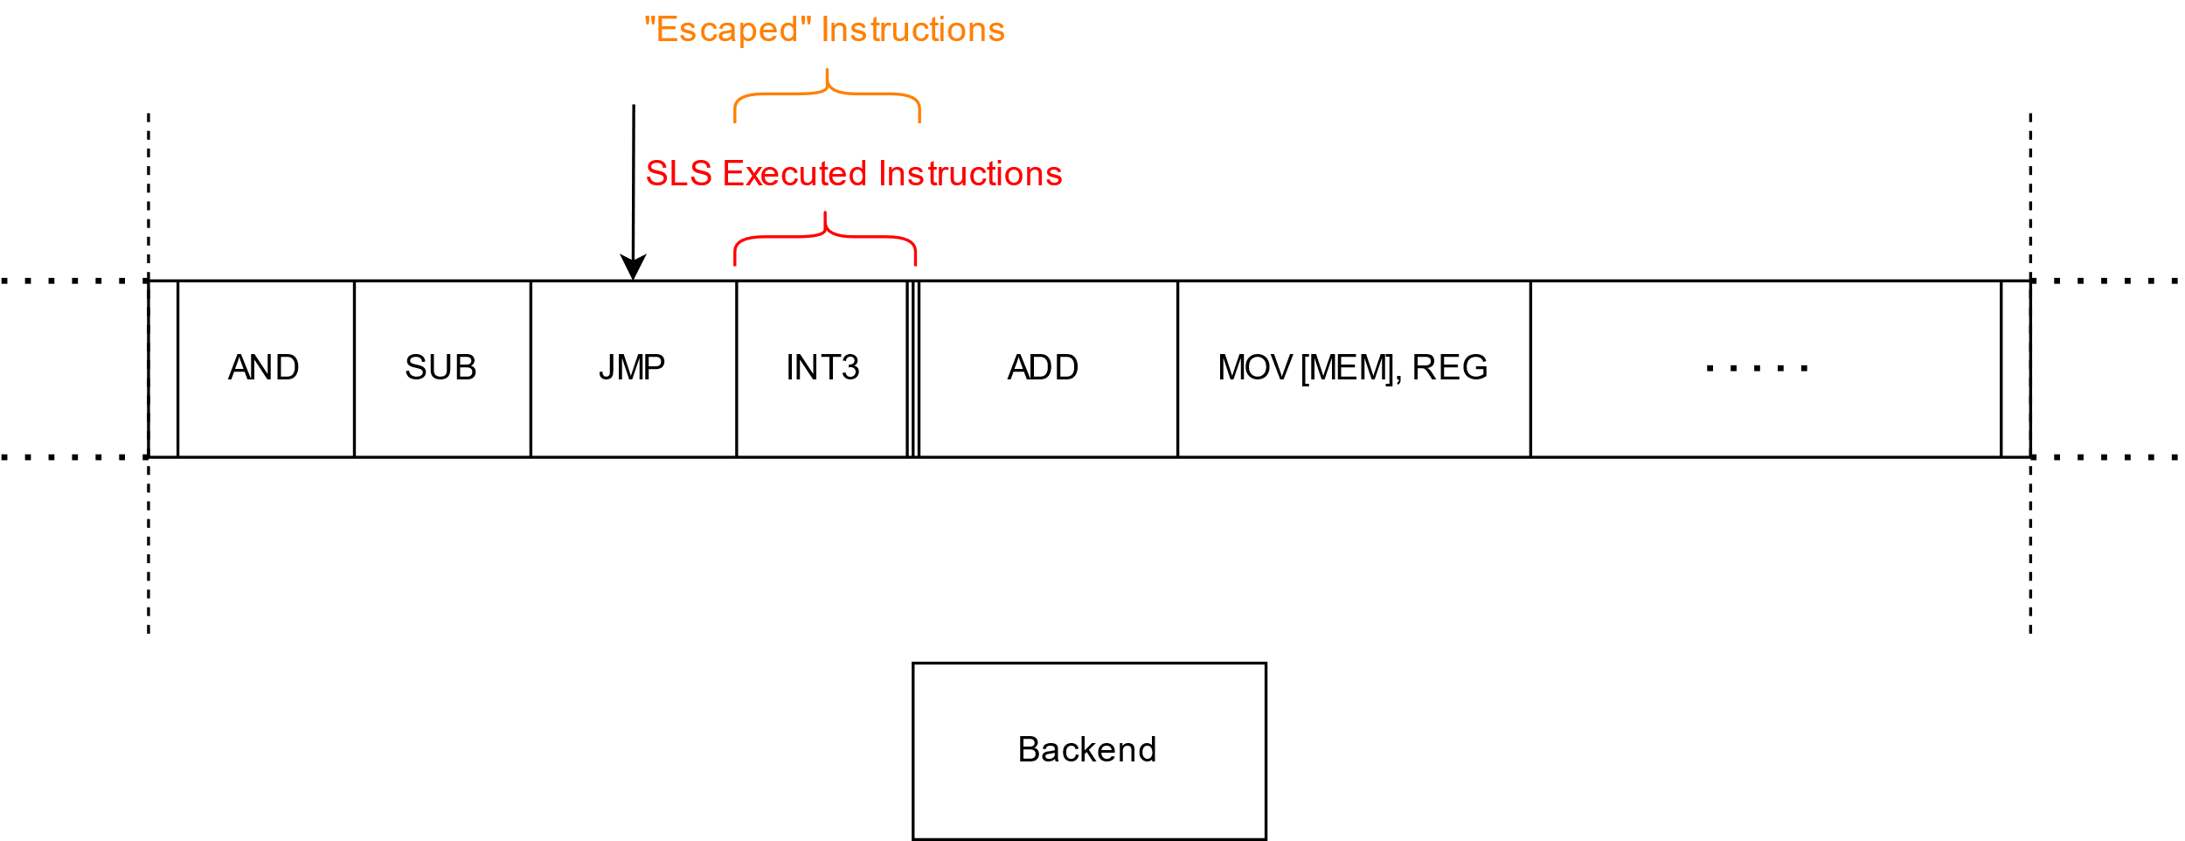
SLS Mitigations

Slide 78
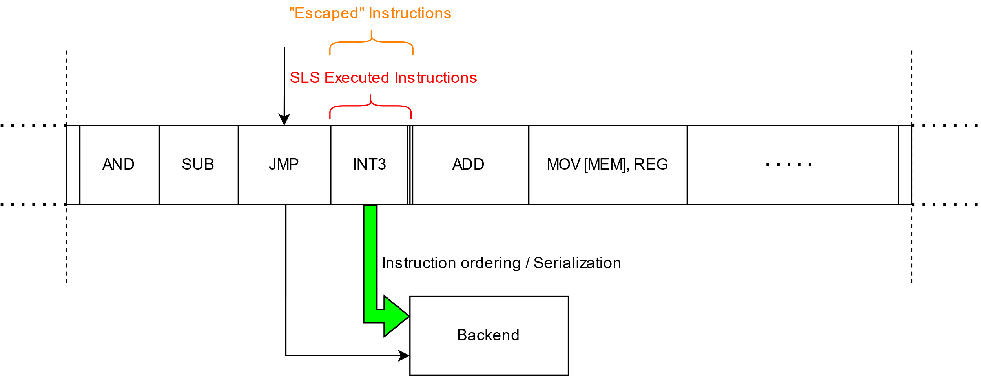
SLS Mitigations

Slide 79
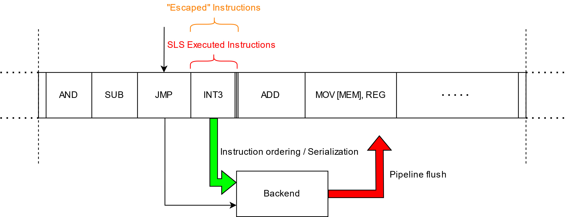
SLS Mitigations

Slide 80
SLS Mitigations

Slide 81
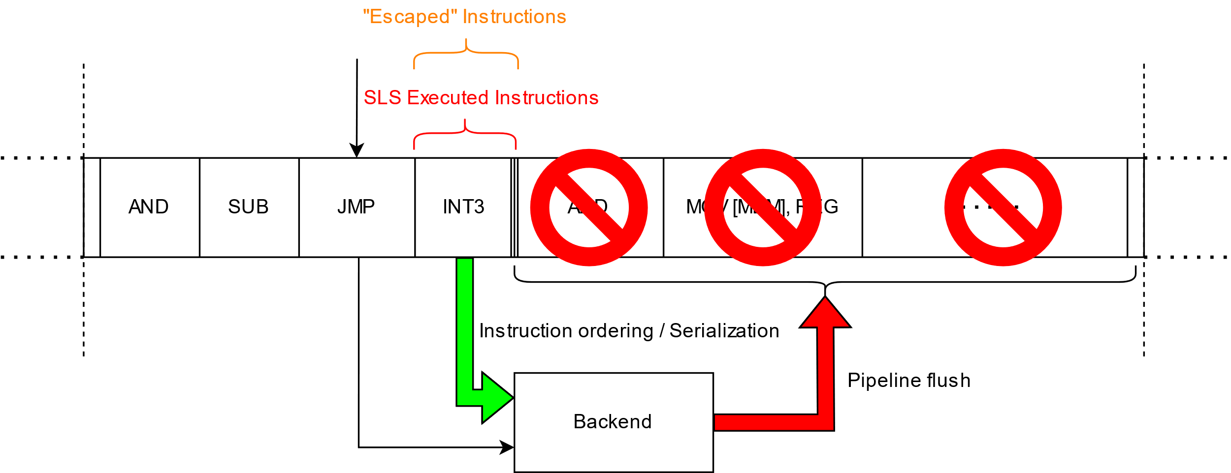
SLS Mitigations

Slide 82
SLS Mitigations
Mitigation for
Direct unconditional call
Indirect unconditional call
LFENCE - Not good for performance!
XOR EAX, EAX – complicated!

Slide 83
SLS Mitigations
Mitigation for
Direct unconditional call
Indirect unconditional call
LFENCE - Not good for performance!
XOR EAX, EAX – complicated!
XOR EAX, EAX
Based on compiler post-call behavior assumptions
Callee-clobbered registers won’t be used without re-write
Callee-preserved registers are preserved – invariant
Only return value register (eax) might be abused
Clearing return value register before the call
Forces eax value to 0 during SLS
No arbitrary content of eax

Slide 84
SLS Mitigations
Mitigation for
Direct unconditional call
Indirect unconditional call
LFENCE - Not good for performance!
XOR EAX, EAX – complicated!
XOR EAX, EAX
Complicated:
Based on compiler assumptions that might not always hold
Compiler implementation dependent
Some calling convention ABIs use eax as function input parameter
Fastcall / regparm(3)
Variadic functions may use eax as parameter
Small structures returned via eax + edx
What to do with:
CALL eax

Slide 85
Thank you
Blogs:
https://grsecurity.net/amd_branch_mispredictor_just_set_it_and_forget_it
https://grsecurity.net/amd_branch_mispredictor_part_2_where_no_cpu_has_gone_before
wipawel@grsecurity.net

