Slide 1
To Branch or Not to Branch
Security Implications of x86 Frontend Implementations
October 2022
Hackers to Hackers Conference (H2HC)
Pawel Wieczorkiewicz
Open Source Security, Inc.

Slide 2
whoami
Pawel Wieczorkiewicz
Email: wipawel@grsecurity.net
Twitter: @wipawel
Security Researcher at Open Source Security, Inc. (creators of grsecurity®)
Low-level security research of system software and hardware
Reverse engineering and binary analysis
Kernel Test Framework (KTF) creator and maintainer
https://github.com/KernelTestFramework/ktf

Slide 3
Outline
Theory
Quick AMD microarchitecture overview
Branch predictors
Basic introduction
Purpose
Building blocks and functionality
Straight-Line Speculation (SLS)
Basic introduction
Root cause mechanics
Types
Practice
CVE-2021-26341: a new unexpected type of SLS
Basic introduction
Speculation window and its limitations
SLS gadgets
Store-to-Load Forwarding (STLF)
SLS mitigations
Spectre v1: Fall-thru speculation of conditional branches
Bounds check latency related out-of-bound array access?
Branch predictor involvement
Speculation window and its limitations

Slide 4
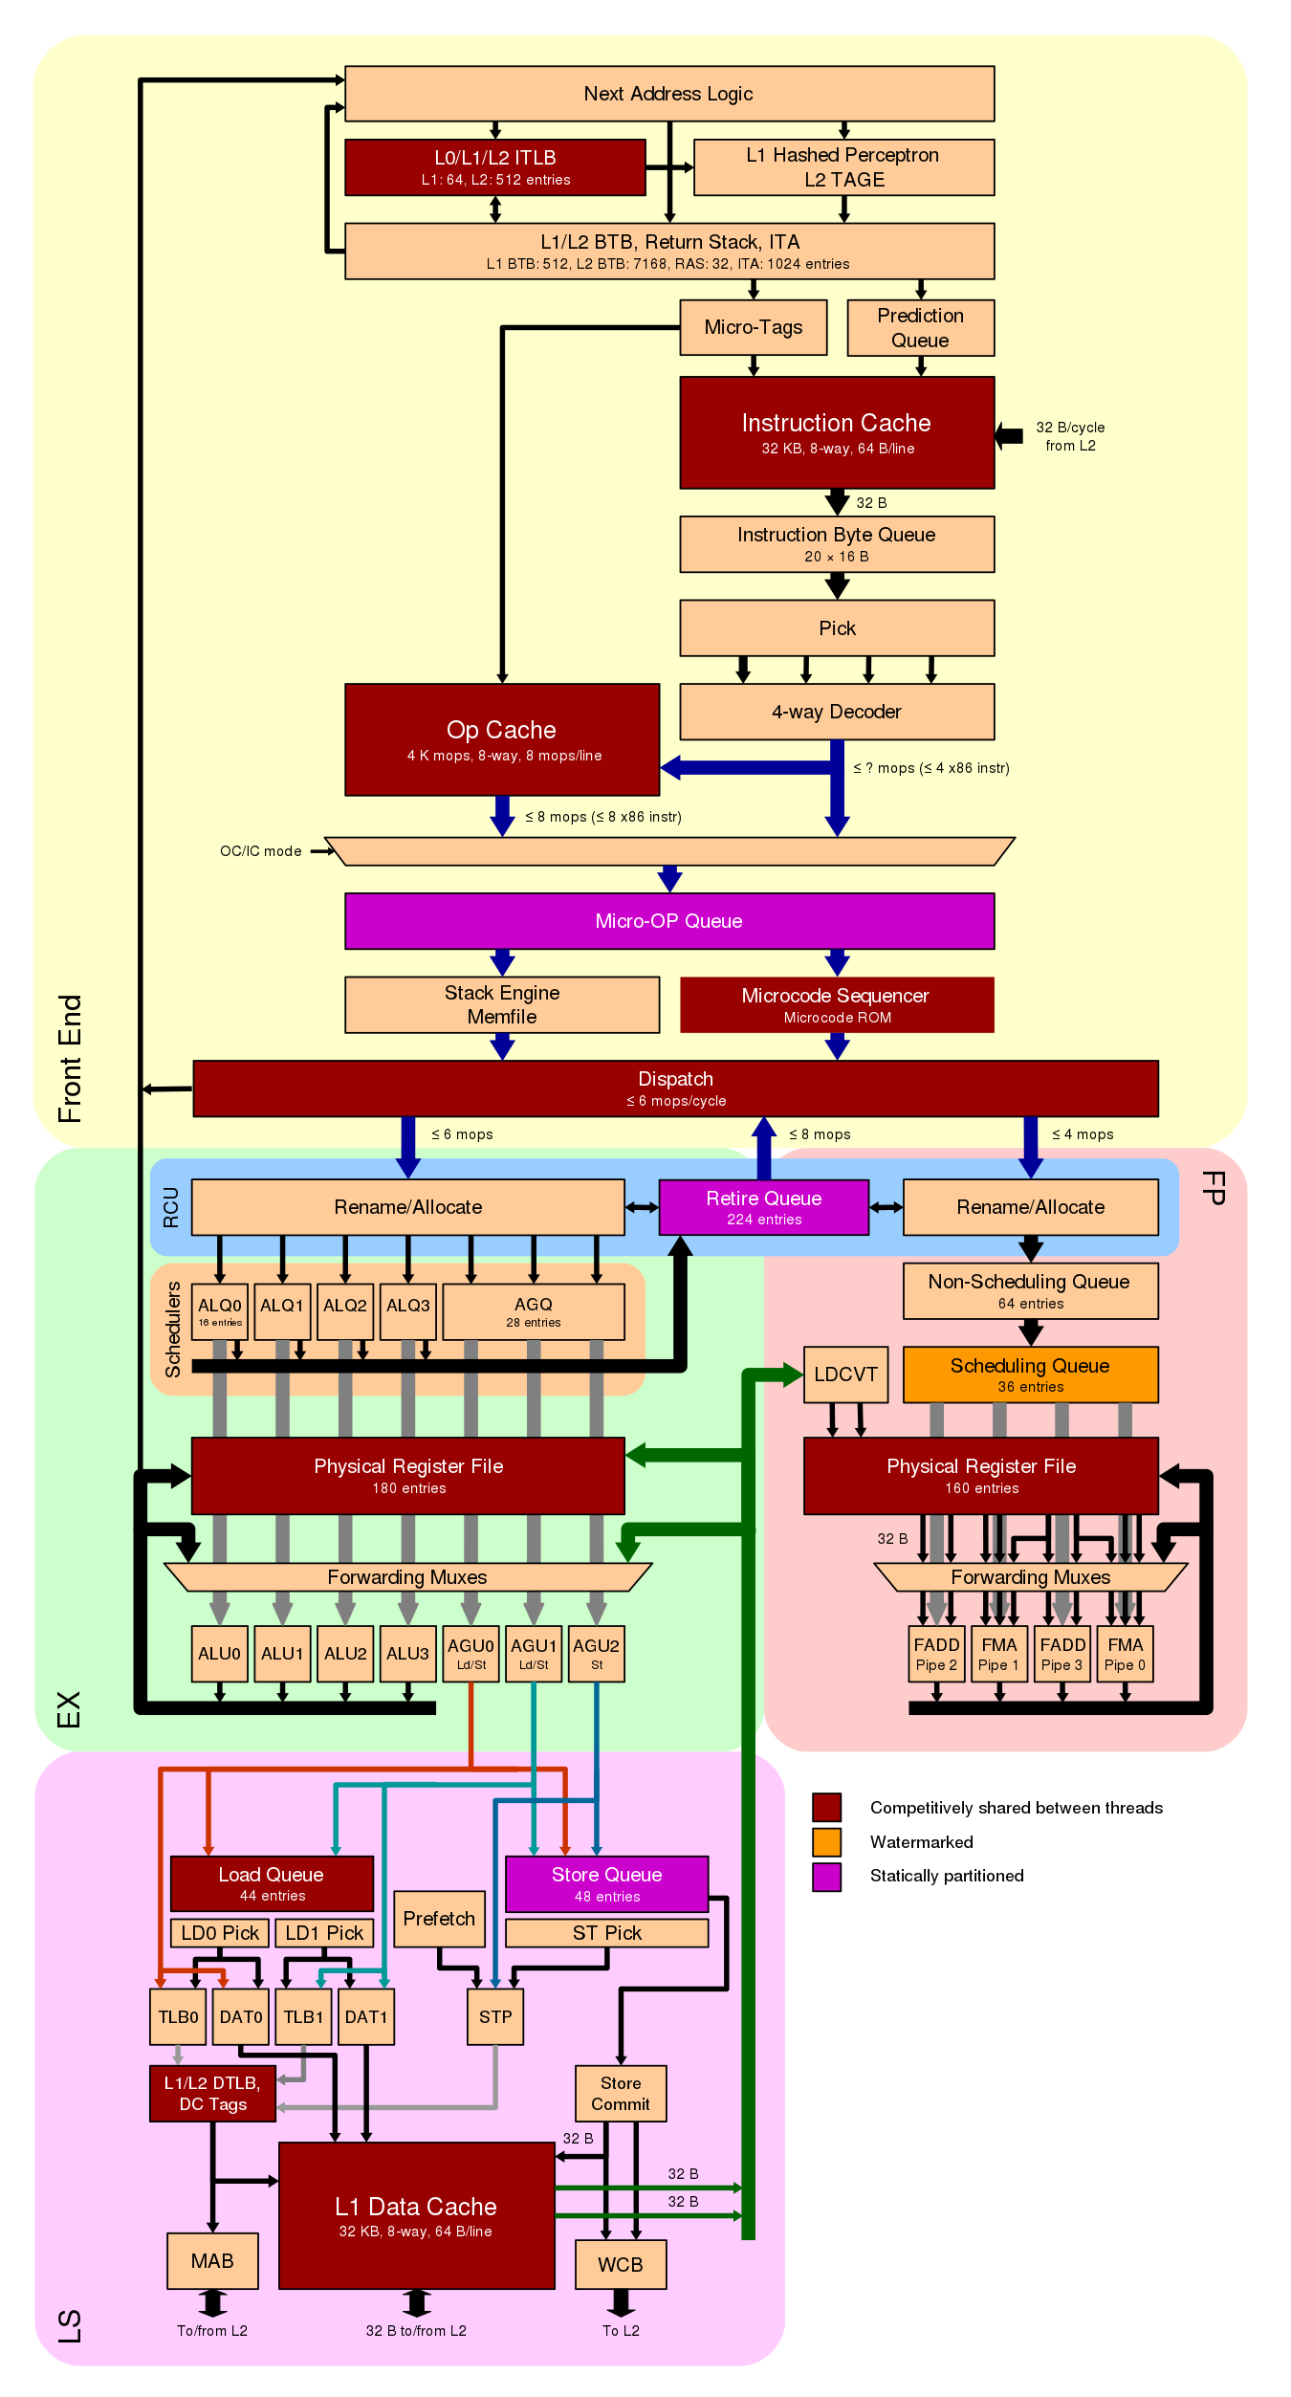
Microarchitecture - overview
AMD Zen2 microarchitecture
source: en.wikichip.org

Slide 5
Microarchitecture - overview
AMD Zen2 microarchitecture
Frontend
source: en.wikichip.org

Slide 6
Microarchitecture - overview
AMD Zen2 microarchitecture
Frontend
Fetch
source: en.wikichip.org

Slide 7
Microarchitecture - overview
AMD Zen2 microarchitecture
Frontend
Fetch
Decode
source: en.wikichip.org

Slide 8
Microarchitecture - overview
AMD Zen2 microarchitecture
Frontend
Fetch
Decode
Dispatch
source: en.wikichip.org

Slide 9
Microarchitecture - overview
AMD Zen2 microarchitecture
Backend
source: en.wikichip.org

Slide 10
Microarchitecture - overview
AMD Zen2 microarchitecture
Backend
Superscalar
source: en.wikichip.org

Slide 11
Microarchitecture - overview
AMD Zen2 microarchitecture
Backend
Superscalar
Out-of-order execution
source: en.wikichip.org

Slide 12
Microarchitecture - overview
AMD Zen2 microarchitecture
Backend
Superscalar
Out-of-order execution
In-order retire
source: en.wikichip.org

Slide 13
Microarchitecture - overview
AMD Zen2 microarchitecture
Frontend
Fetch
Decode
Dispatch
Backend
Superscalar
Out-of-order execution
In-order retire
Frontend
Backend
source: en.wikichip.org

Slide 14
Microarchitecture - overview
AMD Zen2 microarchitecture
Frontend
Fetch
Decode
Dispatch
Backend
Superscalar
Out-of-order execution
In-order retire
Frontend
Backend
source: en.wikichip.org

Slide 15
Microarchitecture - overview
AMD Zen2 microarchitecture
Frontend
Fetch
Decode
Dispatch
Backend
Superscalar
Out-of-order execution
In-order retire
Frontend
Backend
source: en.wikichip.org

Slide 16
Branch predictors - purpose
Why do we need the branch prediction unit (BPU)?
Backend of modern superscalar and out-of-order CPUs can have many instructions “in-flight”
Frontend must keep up supplying instructions to the Backend
Frontend needs to know where to find next instructions to fetch and decode
Easy for sequential execution ➔ next instruction
Problematic upon control flow change (branch)
Two questions:
IF – taken or not taken
Where-to – address of the next instruction
However, some definitive information (e.g., about actual control flow) available only in the Backend

Slide 17
Branch predictors - purpose
Why do we need the branch prediction unit (BPU)?
Backend of modern superscalar and out-of-order CPUs can have many instructions “in-flight”
Frontend must keep up supplying instructions to the Backend
Any feedback from Backend to Frontend may stall the CPU
Must be avoided
Frontend must predict the likely outcome upfront
Correct prediction ➔ performance win
Misprediction ➔ penalty, Frontend re-steer when Backend detects it
The better (more accurate) prediction rate, the better performance (fewer pipeline bubbles)

Slide 18
Branch predictors - design and building blocks
Branch Prediction Unit (BPU)
Many different designs and categories
Static vs Dynamic
One-Level vs Two-level
Local vs Global
Adaptive
Agree
Hybrid
Neural (Machine Learning)
Perceptron-based (AMD Zen2)

Slide 19
Branch predictors - design and building blocks
Branch Prediction Unit (BPU)
Many different designs and categories
Static vs Dynamic
One-Level vs Two-level
Local vs Global
Adaptive
Agree
Hybrid
Neural (Machine Learning)
Perceptron-based (AMD Zen2)
Prediction based on the actual branch instruction and a pre-defined heuristic:
Type of branch
Conditional
Unconditional
Branch direction
Forward
Backward
Examples:
Unconditional branches are always taken
Backward cond. branches taken (loops accuracy)
Forward conditional branches not taken
Unconditional branches are easier to predict than conditional

Slide 20
Branch predictors - design and building blocks
Branch Prediction Unit (BPU)
Many different designs and categories
Static vs Dynamic
One-Level vs Two-level
Local vs Global
Adaptive
Agree
Hybrid
Neural (Machine Learning)
Perceptron-based (AMD Zen2)
Prediction based on previous execution results of a given branch
If taken before, likely to be taken again

Slide 21
Branch predictors - design and building blocks
Branch Prediction Unit (BPU)
Many different designs and categories
Static vs Dynamic
One-Level vs Two-level
Local vs Global
Adaptive
Agree
Hybrid
Neural (Machine Learning)
Perceptron-based (AMD Zen2)
Prediction based on previous execution results of a given branch
If taken before, likely to be taken again
1-bit saturation counter
Previously taken or not taken

Slide 22
Branch predictors - design and building blocks
Branch Prediction Unit (BPU)
Many different designs and categories
Static vs Dynamic
One-Level vs Two-level
Local vs Global
Adaptive
Agree
Hybrid
Neural (Machine Learning)
Perceptron-based (AMD Zen2)
Prediction based on previous executions results of a given branch
If taken before, likely to be taken again
1-bit saturation counter
Previously taken or not taken
2-bit saturation counter
Four states state machine

Slide 23
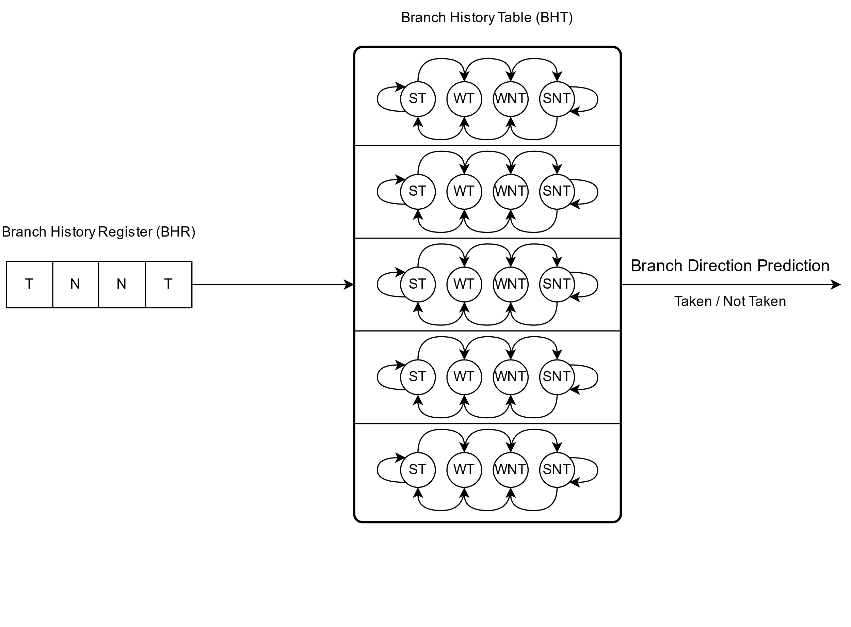
Branch predictors - design and building blocks
Branch Prediction Unit (BPU)
Many different designs and categories
Static vs Dynamic
One-Level vs Two-level
Local vs Global
Adaptive
Agree
Hybrid
Neural (Machine Learning)
Perceptron-based (AMD Zen2)
Prediction is based on a two-dimensional table of 2-bit saturation counters (Branch/Pattern History Table) indexed with branch history register (BHR)

Slide 24
Branch predictors - design and building blocks
Branch Prediction Unit (BPU)
Many different designs and categories
Static vs Dynamic
One-Level vs Two-level
Local vs Global
Adaptive
Agree
Hybrid
Neural (Machine Learning)
Perceptron-based (AMD Zen2)
Branch History Table is indexed using a distinct branch history register (BHR) for each encountered conditional branch

Slide 25
Branch predictors - design and building blocks
Branch Prediction Unit (BPU)
Many different designs and categories
Static vs Dynamic
One-Level vs Two-level
Local vs Global
Adaptive
Agree
Hybrid
Neural (Machine Learning)
Perceptron-based (AMD Zen2)
Branch History Table is indexed using a shared (global) branch history register (GHR) for all encountered conditional branches
Pros:
Correlation between different branches is considered
Cons:
May harm prediction accuracy when too many branches are not correlated

Slide 26
Branch predictors - design and building blocks
Branch Prediction Unit (BPU)
Many different designs and categories
Static vs Dynamic
One-Level vs Two-level
Local vs Global
Adaptive
Agree
Hybrid
Neural (Machine Learning)
Perceptron-based (AMD Zen2)
gshare – Two-level adaptive predictor with global history buffer
Program Counter
Branch History Table (BHT)
ST
WT
WNT
SNT
ST
WT
WNT
SNT
ST
WT
WNT
SNT
Branch Direction Prediction
Taken / Not Taken
ST
WT
WNT
SNT
Global History Register (GHR)
ST
WT
WNT
SNT
T
T
N
T
N
N
T
N
T
N

Slide 27
Branch predictors - design and building blocks
Branch Prediction Unit (BPU)
Many different designs and categories
Static vs Dynamic
One-Level vs Two-level
Local vs Global
Adaptive
Agree
Hybrid
Neural (Machine Learning)
Perceptron-based (AMD Zen2)
Consists of multiple different branch prediction mechanisms
Prediction is based on:
Prediction mechanism that has had highest accuracy in the past
Combined output of all implemented prediction mechanisms

Slide 28
Branch predictors - design and building blocks
So far, we have been implicitly focusing on direct conditional branch predictions
Taken / Not taken
Question: IF – to branch or not to branch ☺

Slide 29
Branch predictors - design and building blocks
So far, we have been implicitly focusing on direct conditional branch predictions
Taken / Not taken
Question: IF – to branch or not to branch ☺
What is the address of a next instruction when the branch is taken?

Slide 30
Branch predictors - design and building blocks
So far, we have been implicitly focusing on direct conditional branch predictions
Taken / Not taken
Question: IF – to branch or not to branch ☺
What is the address of a next instruction when the branch is taken?
What about other branch types?
Do they need a branch predictor too?

Slide 31
Branch predictors - design and building blocks
So far, we have been implicitly focusing on direct conditional branch predictions
Taken / Not taken
Question: IF – to branch or not to branch ☺
What is the address of a next instruction when the branch is taken?
What about other branch types?
Do they need a branch predictor too?
Yes, they do!
Question: Where-to – what is the address of the next instruction?

Slide 32
Branch predictors – branch target buffer
Branch Target Buffer (BTB)
Another important BPU component:
Branch Target Buffer (BTB)
Branch Target Address 1
Branch Target Address 2
Branch Target Address 3
...
Branch Target Address N
Target Address Prediction

Slide 33
Branch predictors – branch target buffer
Branch Target Buffer (BTB)
Another important BPU component:
Branch Target Buffer (BTB)
Predicts address of next instructions after the control flow changes because of a branch
Table of branch target addresses
indexed with a value derived from a current branch’s program counter value (address)
Branch Target Address 1
Branch Target Address 2
Branch Target Address 3
...
Branch Target Address N
Target Address Prediction

Slide 34
Branch predictors – branch target buffer
Branch Target Buffer (BTB)
Turns out: ALL branch types need BTB! Why?
Frontend fetches and decodes, but does not execute (nor specifically analyses) instructions
With a few exceptions, e.g.:
int3 - #BP debug exception
call 0h – get PC thunk
Upon a branch, frontend needs to know (instantly) where to fetch next instructions from
It must not wait for Backend ➔ Performance!
Hence, BPU is frontend’s component and leverages BTB to steer frontend upon branches
Branch Target Address 1
Branch Target Address 2
Branch Target Address 3
...
Branch Target Address N
Target Address Prediction

Slide 35
Branch predictors – branch target buffer
Branch Target Buffer (BTB)
Analyzing exact branch instructions’ addressing is backend’s job
The Where-to problem:
Direct conditional branches:
Not taken ➔ next instruction
easy
Taken ➔ where-to?
backward? forward? not easy
Direct unconditional branches:
Always taken ➔ where-to?
backward? forward? not easy
Indirect unconditional branches:
Always taken ➔ where-to?
backward? forward? not easy
Target address may change at runtime, not static
static prediction will not do
BTB is crucial for performance
Branch Target Address 1
Branch Target Address 2
Branch Target Address 3
...
Branch Target Address N
Target Address Prediction

Slide 36
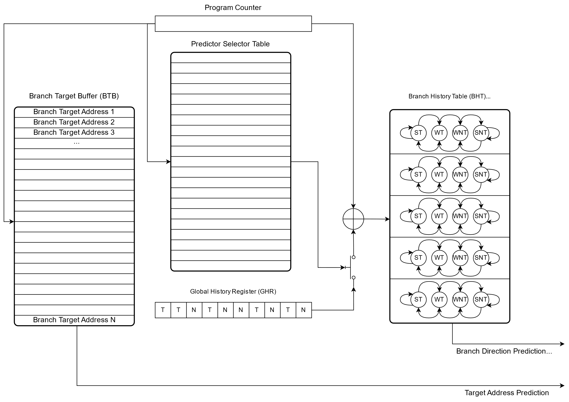
Hybrid branch predictor – building blocks diagram

Slide 37
Hybrid branch predictor – building blocks diagram – Taken/Not Taken
Answer: IF

Slide 38
Hybrid branch predictor – building blocks diagram – Where-to
Answer: Where-to

Slide 39
Straight-Line Speculation (SLS) - introduction
Straight-Line Speculation term was coined by Arm
result of Google SafeSide project research - CVE-2020-13844
Arm described SLS as a speculative execution past an unconditional change in the control flow: "Straight-line speculation would involve the processor speculatively executing the next instructions linearly in memory past the unconditional change in control flow“
Initially observed on indirect unconditional branches on Arm CPUs
Shortly after, the SLS was also observed on “some x86 CPUs”
Also, on indirect unconditional branches
However:
SLS had to have been observed on x86 CPUs prior to Arm coining the term
Appearance of traps after RET instructions:
~2018: Microsoft Windows
~2019: grsecurity

Slide 40
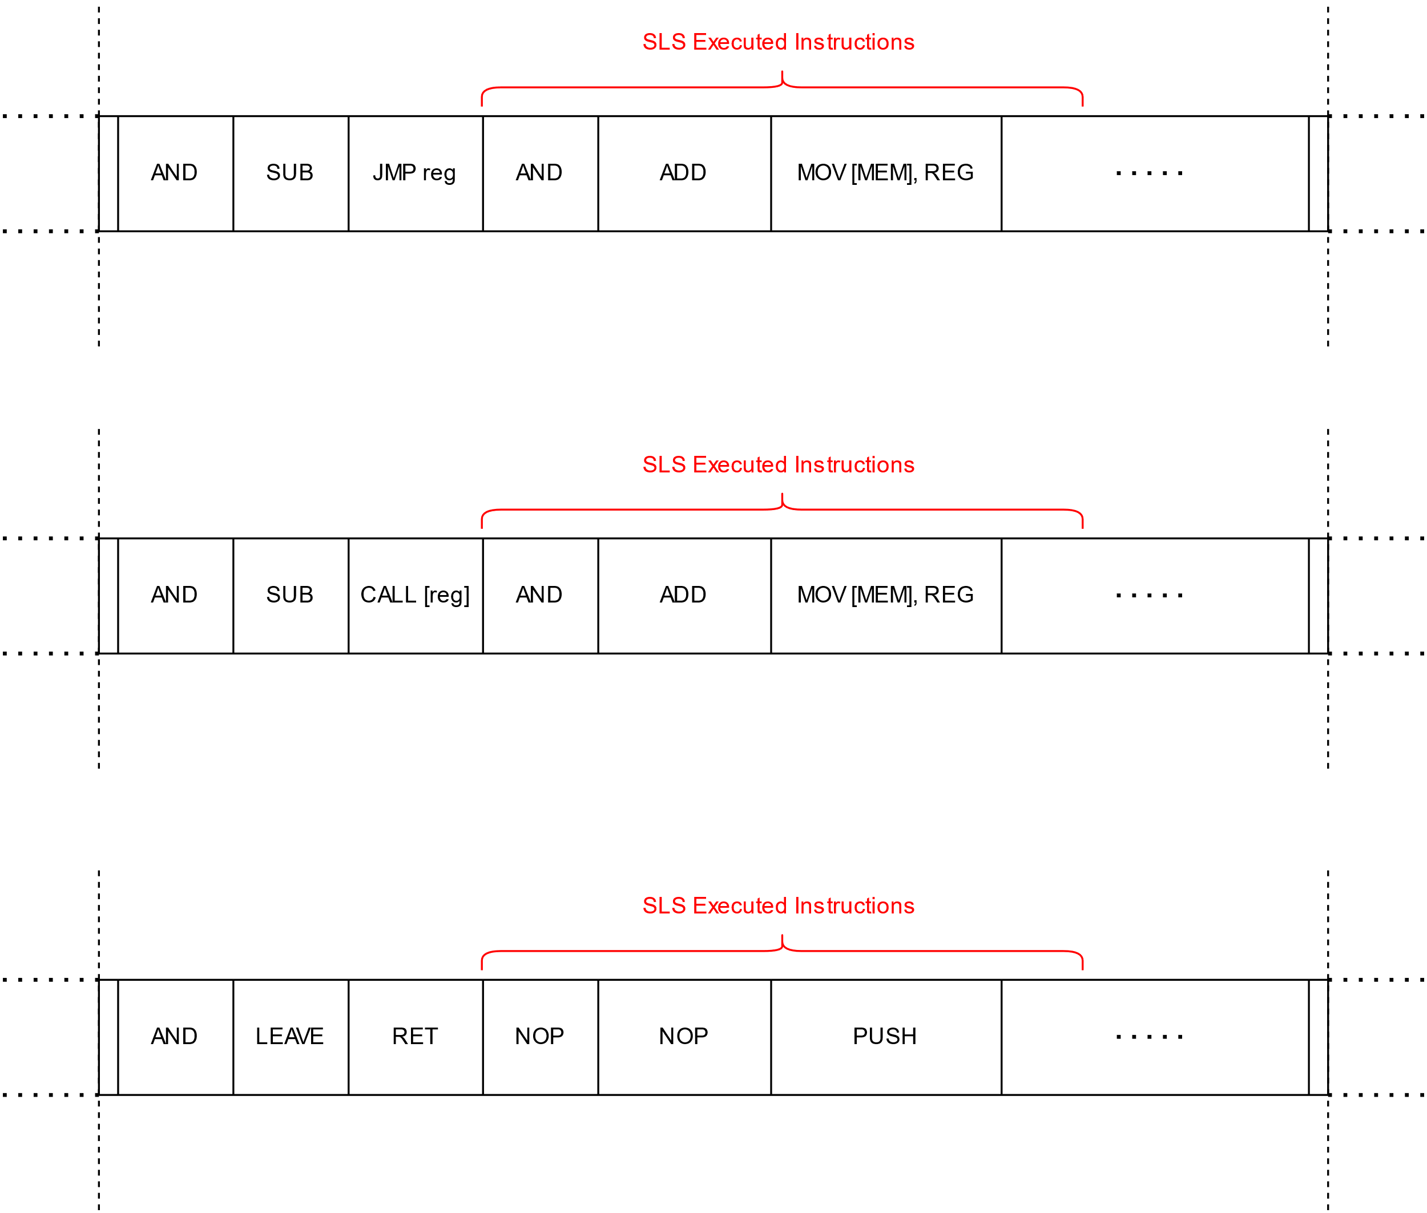
Straight-Line Speculation (SLS)
Types of SLS
Indirect
Unconditional
Jump and Call
JMP/CALL reg
JMP/CALL [mem]
Function return
RET

Slide 41
Straight-Line Speculation (SLS)
Types of SLS
Indirect
Unconditional
Jump and Call
JMP/CALL reg
JMP/CALL [mem]
Function return
RET
What about direct branches?

Slide 42
CVE-2021-26341 - Direct unconditional branch SLS
AMD x86 CPUs (Zen1 and Zen2 microarchitectures)
All direct unconditional branch instructions experience SLS vulnerability too!
JMP $relative_offset
CALL $relative_offset
Branch direction does not matter
Both forward and backward branches suffer from SLS
It is possible to trigger SLS between two co-located hyper-threads
AMD x86 CPU (Zen3 microarchitecture)
SLS on direct unconditional branches seems to be fixed
Big design upgrade of the branch predictor unit
Intentional or accidental?

Slide 43
CVE-2021-26341 - Direct unconditional branch SLS
Why would a modern CPU speculate past a direct unconditional branch?
After all:
Its target address is static!
And encoded as part of the branch instruction!
There is no latency involved
It is unconditional – no need to spend time on evaluating any conditions
Let’s see why…

Slide 44
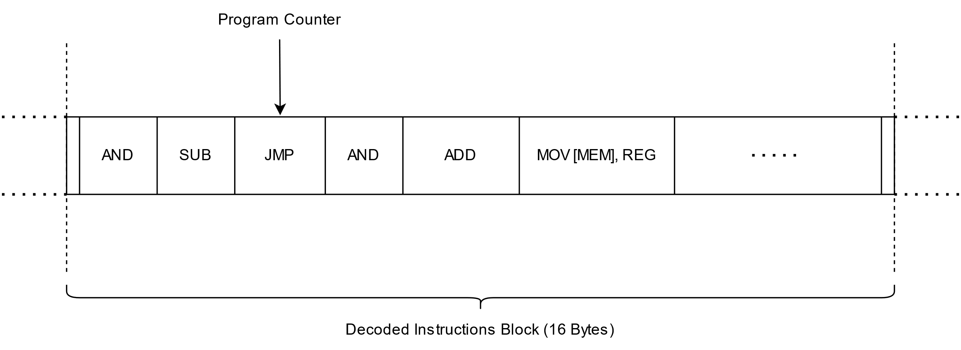
Straight-Line Speculation (SLS) - mechanics

Slide 45
Straight-Line Speculation (SLS) - mechanics
Branch

Slide 46
Straight-Line Speculation (SLS) - mechanics
Branch Target Buffer
Branch

Slide 47
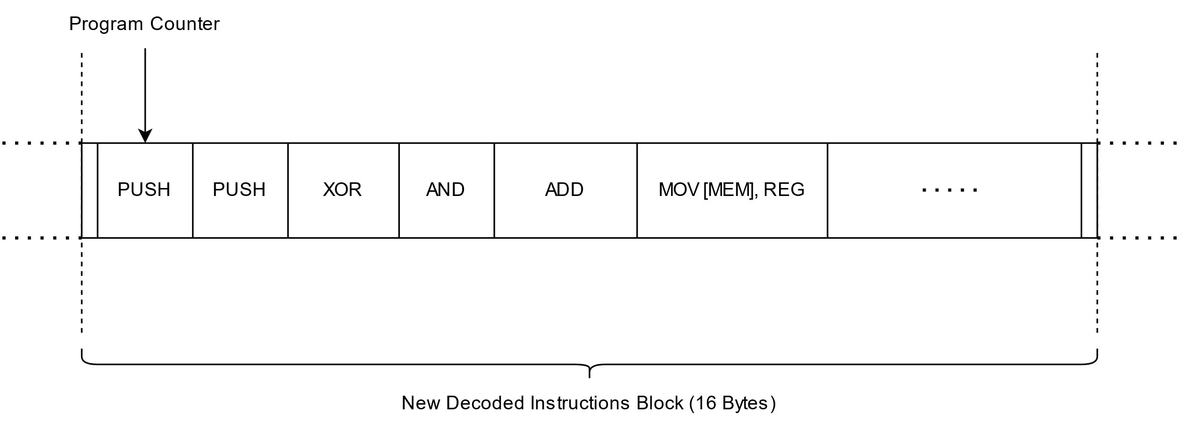
Straight-Line Speculation (SLS) - mechanics
Jump target address
Predicted correctly

Slide 48
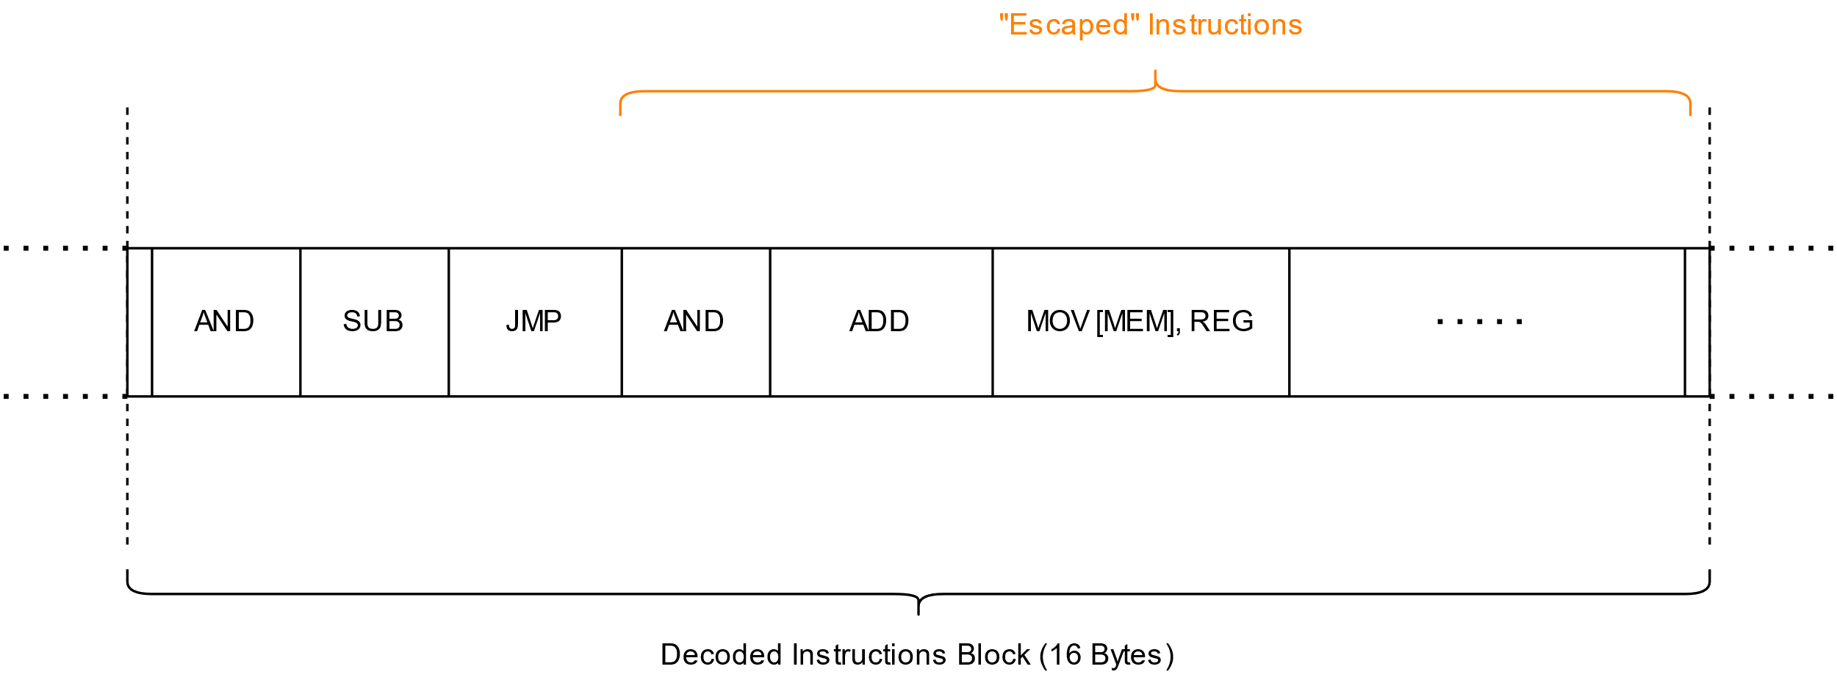
Straight-Line Speculation (SLS) - mechanics
Mispredicted

Slide 49
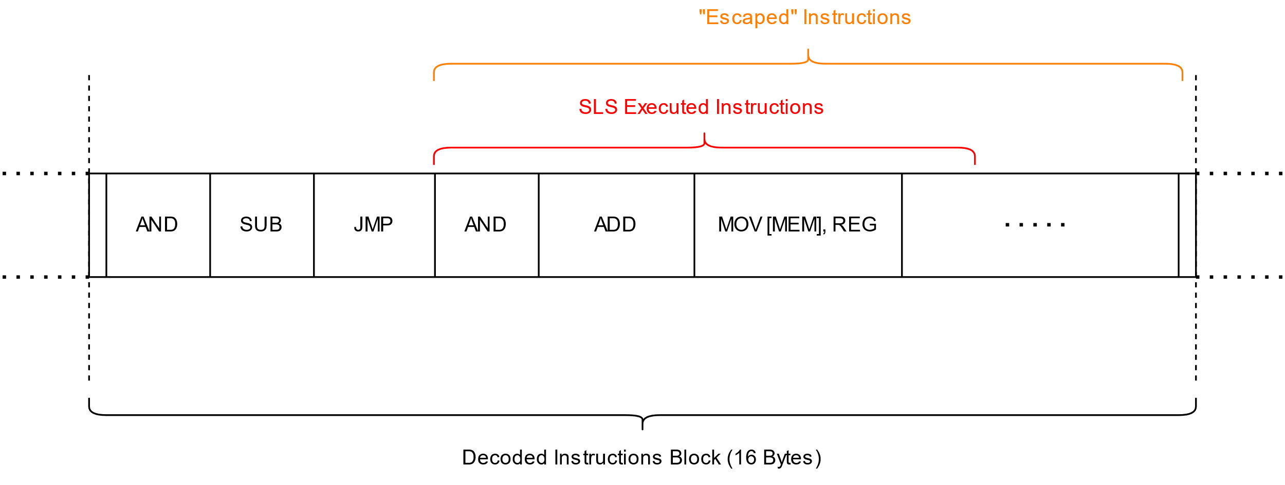
Straight-Line Speculation (SLS) - mechanics

Slide 50
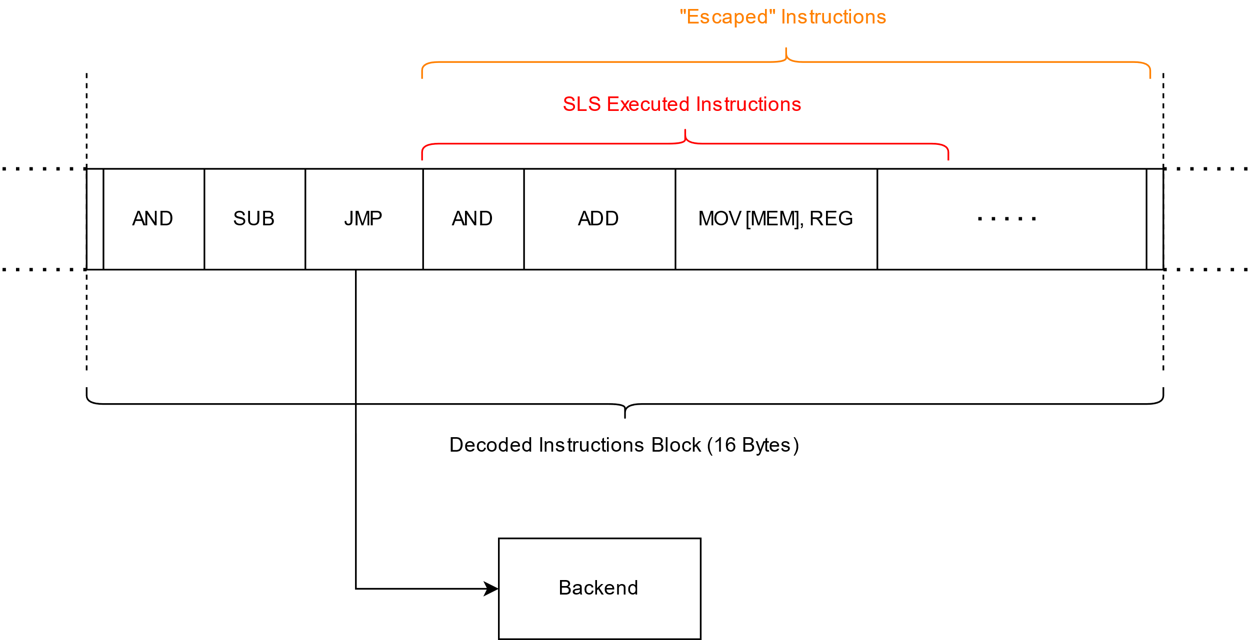
Straight-Line Speculation (SLS) - mechanics

Slide 51
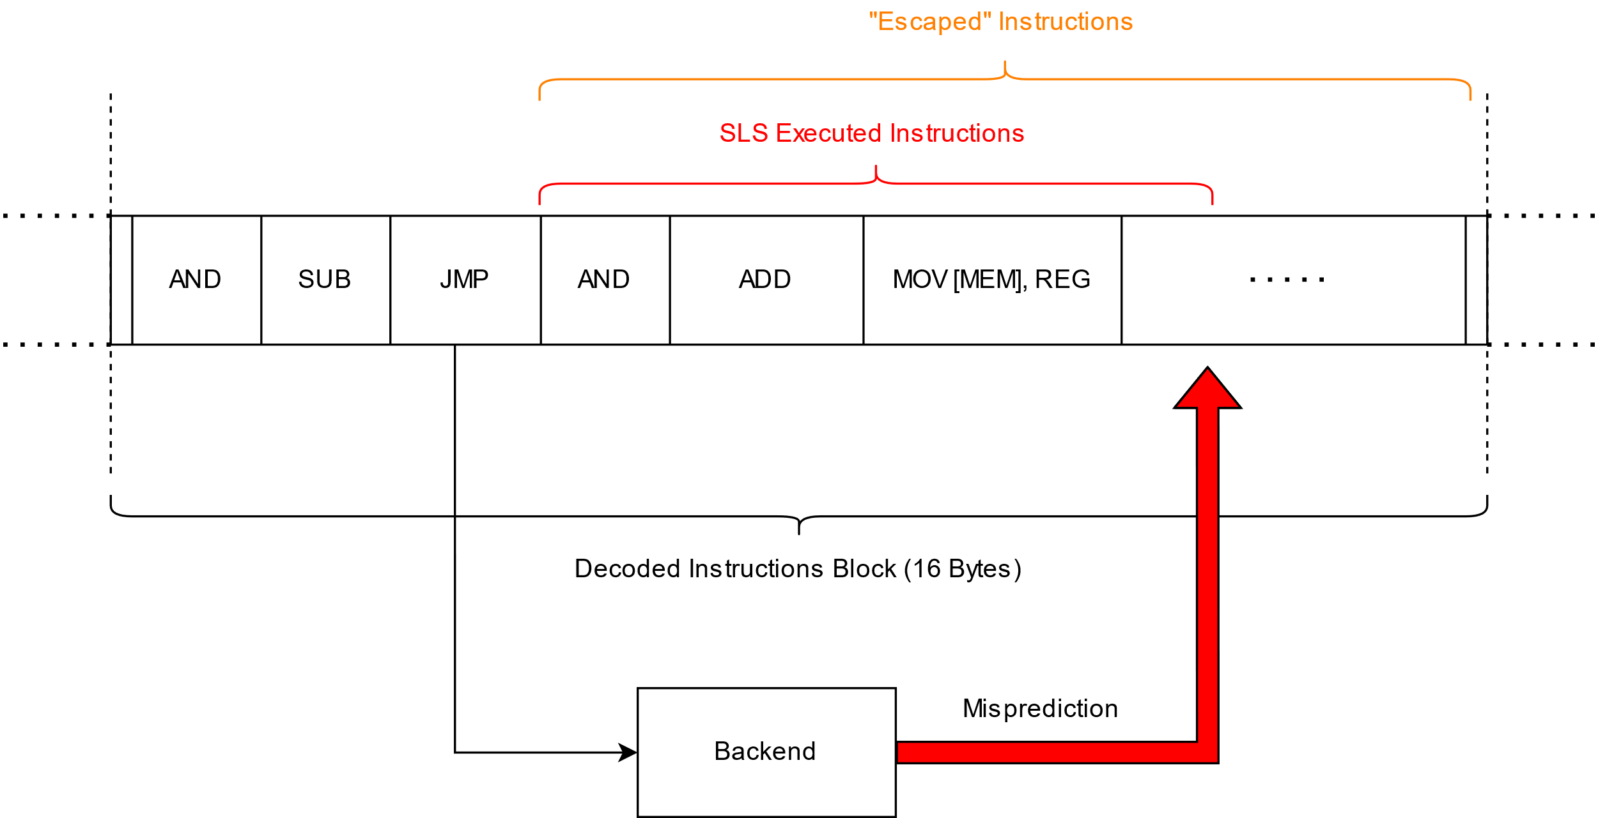
Straight-Line Speculation (SLS) - mechanics

Slide 52
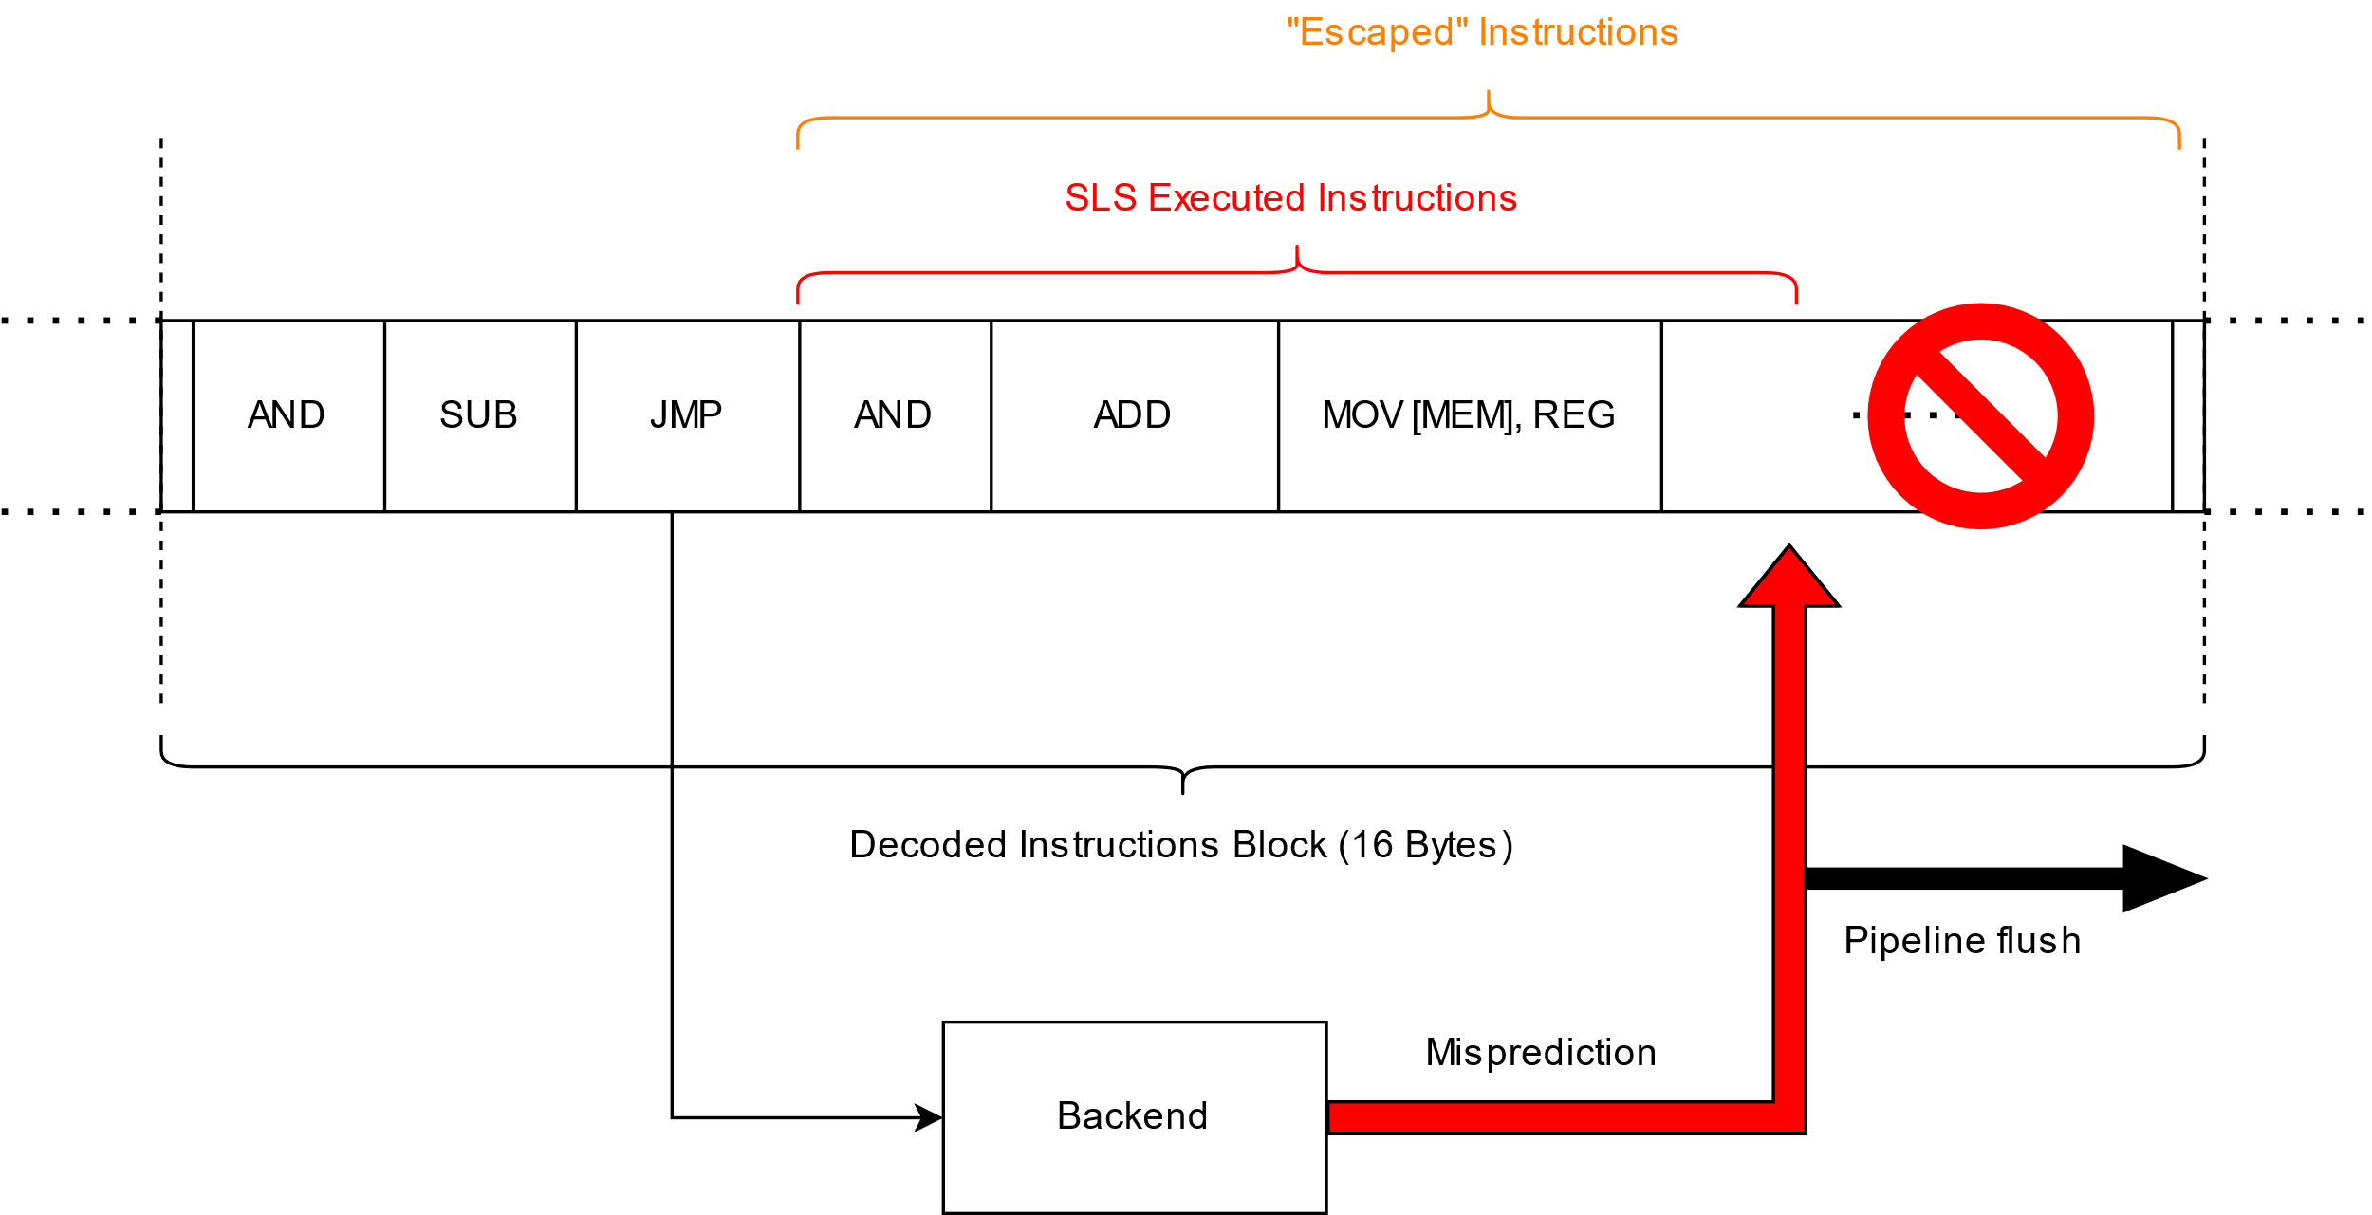
Straight-Line Speculation (SLS) - mechanics

Slide 53
CVE-2021-26341 - Direct unconditional branch SLS
If there is no entry in the BTB (or Return Address Stack (RAS) for RET instructions)
the branch will be mispredicted and SLS might occur
Any branch type!
What does it mean?
We can easily and almost 100% reliably make affected AMD CPUs mispredict any branch …
Direct or indirect
Conditional or unconditional
… and trigger SLS past it.
How?
We need to make sure the corresponding BTB entry is not present
Simplest way: flushing entire BTB

Slide 54
CVE-2021-26341 - Direct unconditional branch SLS
Flushing entire BTB
Execute a large enough number of consecutive branches
Each will take at least one entry in the BTB
BTB entries can hold up to two branches within the same 64-byte instruction block
Provided the first branch is a conditional branch
Solution
Place two unconditional branches within a single cache-line
Upon execution at least one entry of the BTB will be taken
Repeat this code construct a NUMBER of times
Entire BTB overwritten if the NUMBER is equal to or greater than the number of entries of the given BTB
Or… (ab)use Spectre v2 mitigations
Trigger IBPB
via MSR write or by context/privilege switch
.macro flush_btb NUMBER
; start at a cache-line size aligned address
.align 64
; repeat the code between .rept and .endr
; directives a NUMBER of times
.rept \NUMBER
jmp 1f ; first unconditional jump
.rept 30 ; half-cache-line-size padding
nop
.endr
1: jmp 2f ; second unconditional jump
.rept 29 ; full cache-line-size padding
nop
.endr
2: nop
.endr
.endm

Slide 55
CVE-2021-26341 - Direct unconditional branch SLS
Speculation window
up to 8 simple and short (up to 16 bytes) x86 instructions can be speculatively executed
in practice: 4-5 short x86 instructions that do not compete for execution units
up to 2 memory loads can be executed speculatively
the loads (even pre-cached) cannot provide data to the following µops in time
the loads do get scheduled and can leave traces in cache hierarchy
Limitations
constructing a full Spectre v1 gadget is not possible with this type of SLS
Secret data needs to be available in GPR (registers) for the SLS gadget
or…

Slide 56
CVE-2021-26341 - Direct unconditional branch SLS
Store-To-Load-Forwarding (STLF)
Forwarding data of a completed (but not yet retired) stores to the later loads
Stores are buffered in the Store Queue (WAW and WAR dependencies)
Later loads must get fresh data either from the Store Queue (if fresh) or memory
Memory loads executed under SLS receive data from the earlier stores to the same address
STLF enables speculative loads under SLS to execute fast enough
Such loads do provide data to their dependent µops!
STLF requirements
Earlier store contains all the load’s bytes (cannot load more than has been stored)
CPU uses memory load address bits 11:0 to determine STLF eligibility
Same address space and ideally same registers, closely grouped together
Notes:
WAW – Write after write
i1. R2 <- R4 + R7
i2. R2 <- R1 + R3
i2 tries to write an operand before it is written by i1
WAR – Write after read
i1. R4 <- R1 + R5
i2. R5 <- R1 + R2
i2 tries to write a destination before it is read by i1

Slide 57
CVE-2021-26341 - Direct unconditional branch SLS
wipawel@pawel-poc:~$ time taskset -c 2 ./readlink Baseline: 200
Secret: 4141414141414141
Result: 0000ffffffffff40
Result: 0000ffffffefff40
Result: 0000fdffffefff40
Result: 0000fdffffeff740
Result: 0000fddfffeff740
Result: 0000fddbffeff740
Result: 0000fddbfbeff740
Result: 0000fddbfbe7f740
Result: 0000fd5bfbe7f740
Result: 0000fd5b7be7f740
Result: 0000fd5b7be7f540
Result: 0000fd5b7be7e540
Result: 0000fd5b7be5e540
Result: 0000fd5b7be1e540
Result: 0000fd5b7be1c540
Result: 0000fd4b7be1c540
Result: 0000fd437be1c540
Result: 0000f5437be1c540
Result: 0000f5437bc1c540
Result: 0000f5417bc1c540
Result: 0000f54179c1c540
Result: 0000f54169c1c540
Result: 0000e54169c1c540
Result: 0000c54169c1c540
Result: 0000c5416941c540
Result: 0000c5414941c540
Result: 0000c54149414540
Result: 0000c54149414140
Result: 0000c14149414140
Result: 0000414149414140
Result: 0000414141414140
real 0m14.620s user 0m11.650s sys 0m2.875s
Direct unconditional branch SLS with STLF gadget PoC example
asm goto (
"mov $0x4141414141414141, %%rbx\n“
"mov %%rbx, (%0)\n“
"sfence\n“
"lfence\n“
".align 64\n“
"jmp %l[end]\n“
"mov (%0), %%rbx\n“
"and %1, %%rbx\n“
"add %2, %%rbx\n“
"mov (%%rbx), %%ebx\n“
:: "r" (&path), "r" (1UL << bufsiz), "r" (buf)
: "rbx", "memory“
: end);
end:

Slide 58
CVE-2021-26341 - Direct unconditional branch SLS
Vulnerable pipeline
Pipeline leak
Source: https://p0.pxfuel.com/preview/170/208/982/gas-production-technology-power.jpg
Source: Nord Stream natural gas pipelines spring multiple leaks | Oil & Gas Journal (ogj.com)

Slide 59
SLS Mitigations
First, we discuss SLS mitigation for the following branches:
Direct unconditional jump
Indirect unconditional jump
Function return RET
These three cases are easy to mitigate
Just follow them with a speculative execution barrier (i.e., serializing or ordering instruction)
The shorter the barrier instruction the better
Never gets executed architecturally
SLS mitigation for direct or indirect call is not that simple
At some point control flow resumes execution at an instruction following the call
The speculative execution barrier does get executed architecturally
Should be fast and must not have architectural “side-effects”

Slide 60
SLS Mitigations – jumps and rets
The simplest yet effective and therefore commonly used mitigation for
Direct unconditional jump
Indirect unconditional jump
Function return RET
is the INT3 instruction
single byte opcode (0xCC)
#BP exception generation caught at the decode stage in the frontend
What does it look like in action?

Slide 61
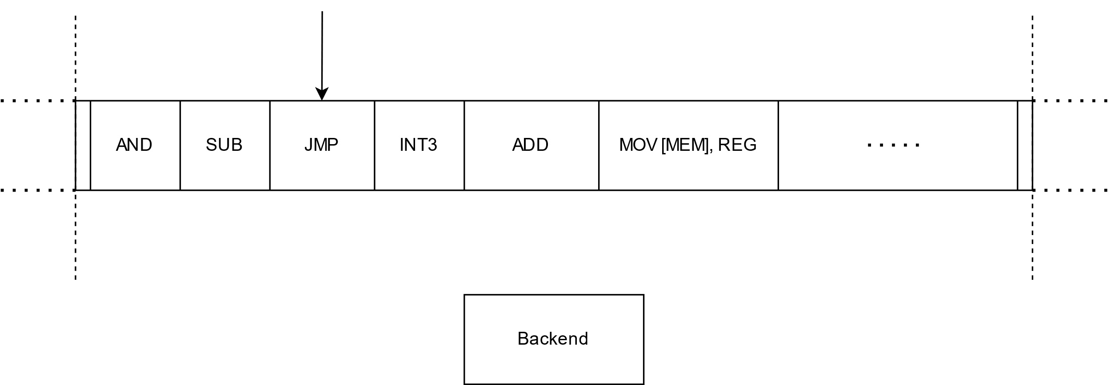
SLS Mitigations – jumps and rets

Slide 62
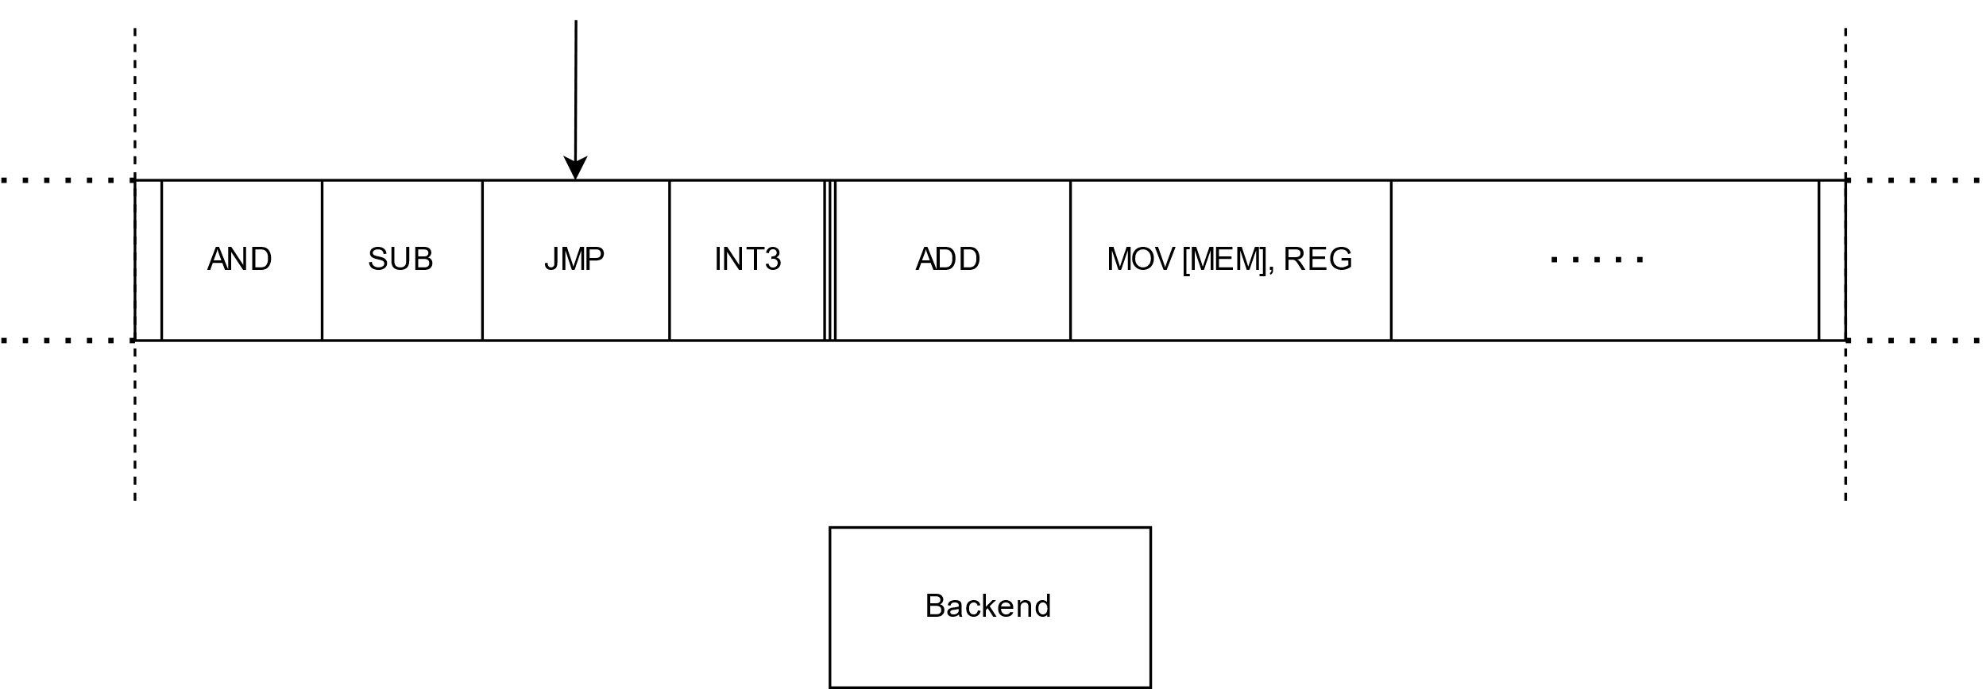
SLS Mitigations – jumps and rets

Slide 63
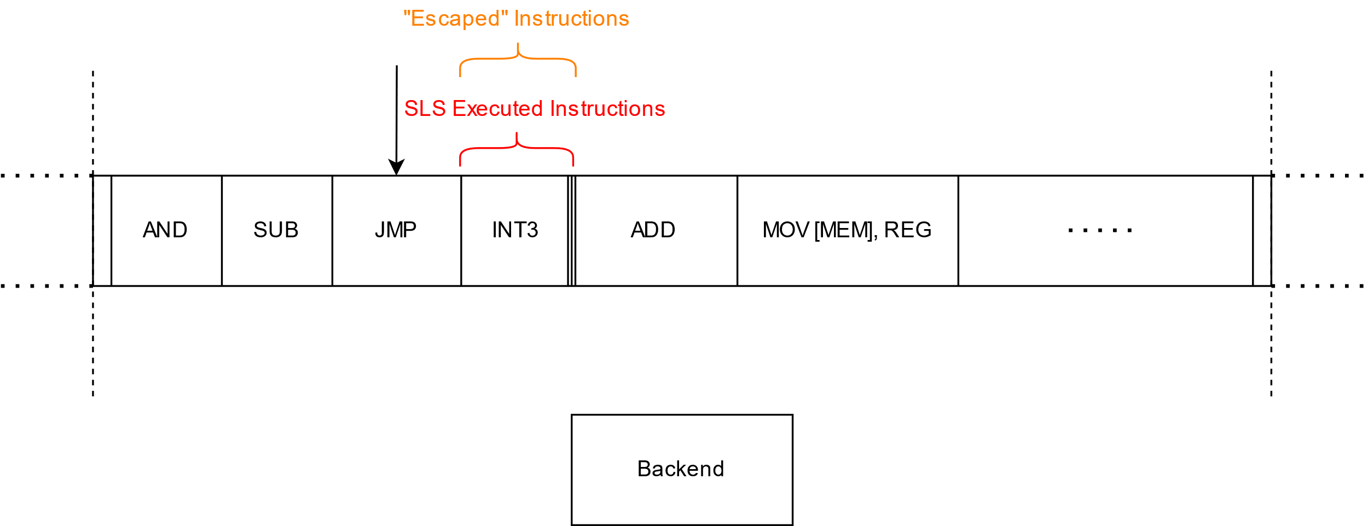
SLS Mitigations – jumps and rets

Slide 64
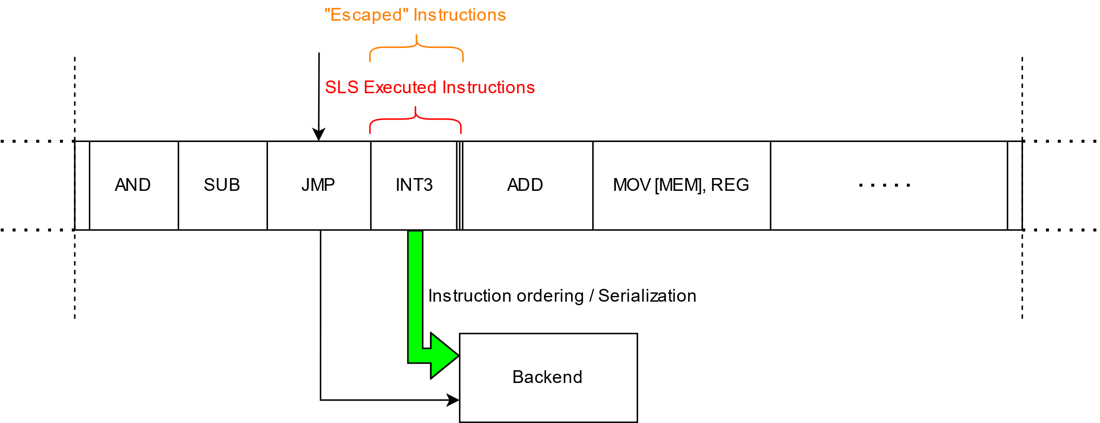
SLS Mitigations – jumps and rets

Slide 65
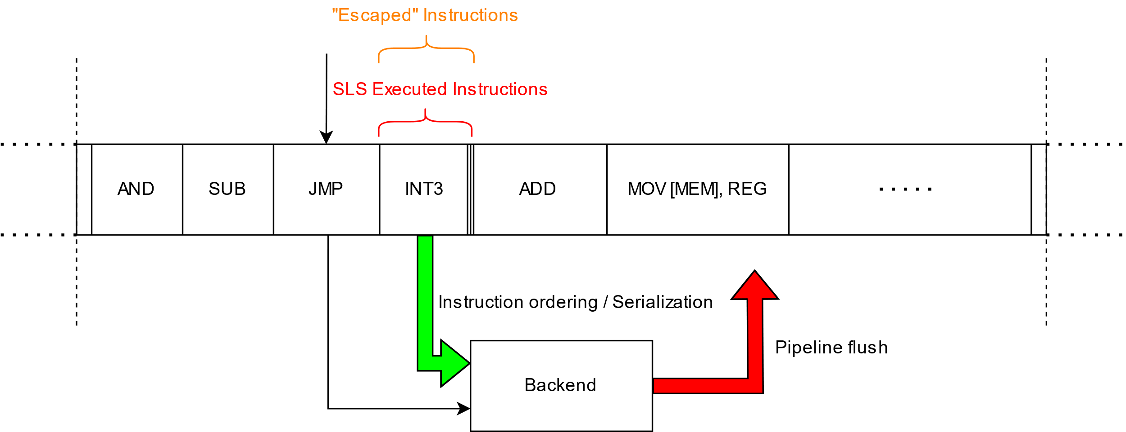
SLS Mitigations – jumps and rets

Slide 66
SLS Mitigations – jumps and rets

Slide 67
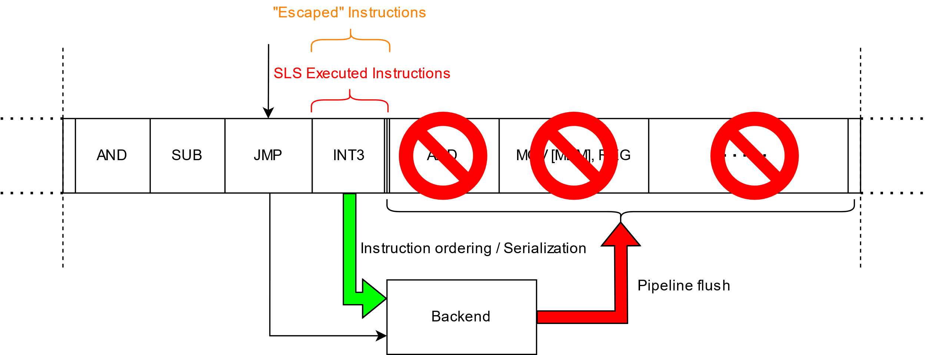
SLS Mitigations – jumps and rets

Slide 68
SLS Mitigations - calls
What is an optimal SLS mitigation for calls?
Direct unconditional call
Indirect unconditional call
LFENCE
No architectural “side-effects”
Memory ordering and/or serializing instructions
Gets executed architecturally after every call - not good for performance!
XOR EAX, EAX
Wait, what!?
It’s complicated…

Slide 69
SLS Mitigations - calls
XOR EAX, EAX
Idea based on compiler post-call behavior assumptions
Callee-clobbered registers won’t be used without a re-write
Callee-preserved registers are preserved – invariant
Return value register (eax) is assumed to be modified by the callee code
➔ Hence, under SLS, only return value register (eax) might be abused
Clearing return value register before the call is sufficient as a mitigation
Forces eax value to 0 during SLS instead of a potentially arbitrary content

Slide 70
SLS Mitigations - calls
XOR EAX, EAX
Why is it complicated?
Based on compiler behavior assumptions that might not always hold
Compiler implementation dependent
Some calling convention ABIs use return value register (eax) as function input parameter
Fastcall / regparm(3)
Variadic functions may use eax as parameter
Functions may return small structures via eax + edx registers
What to do with:
CALL eax

Slide 71
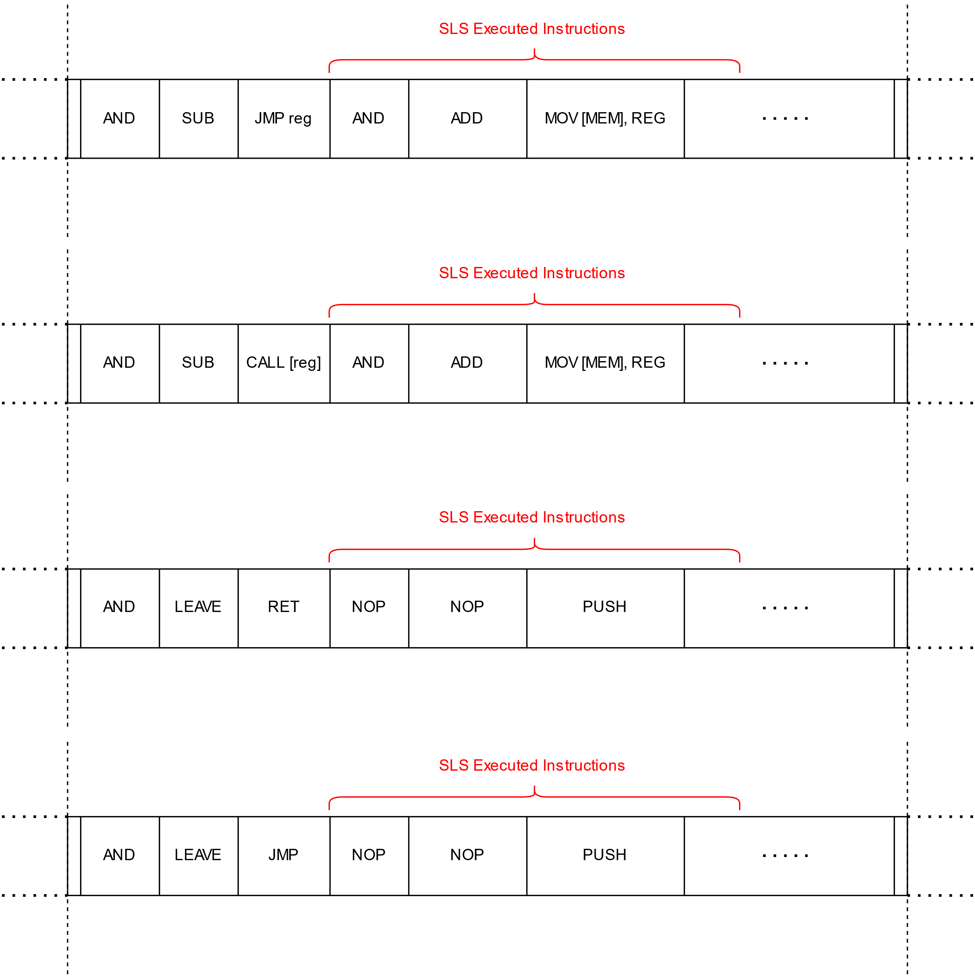
Straight-Line Speculation (SLS)
Types of SLS
Indirect
Unconditional
Jump and Call
JMP/CALL reg
JMP/CALL [mem]
Function return
RET
Direct
Unconditional
Jump and Call
JMP/CALL $rel_offset

Slide 72
Straight-Line Speculation (SLS)
Types of SLS
Indirect
Unconditional
Jump and Call
JMP/CALL reg
JMP/CALL [mem]
Function return
RET
Direct
Unconditional
Jump and Call
JMP/CALL $rel_offset
What about direct conditional branches?

Slide 73
Speculation of conditional branches
Both paths of conditional branches (taken or not taken) are architecturally legitimate
Hence, there is no direct conditional branch SLS
Rather, we speak of a branch fall-through speculation
Assuming a conditional branch is architecturally taken
When mispredicted ➔ Its not taken path could be speculatively executed too
Such conditional branch fall-through speculation may lead to Spectre v1-like vulnerability situations

Slide 74
Fall-through speculation of conditional branches
AMD x86 CPUs (Zen1, Zen2 and Zen3 microarchitectures)
All conditional branch instructions may experience a fall-through speculation
Root-cause similar to the direct unconditional branch SLS
When BPU mispredicts or otherwise mis-detects the conditional branch
No BTB entry for the branch instruction ➔ fall-through speculation
Even very simple conditional branches with trivially evaluated conditions are susceptible!
Branch direction does not matter
Both forward and backward branches suffer from the fall-through speculation
It is possible to trigger the fall-through speculation between two co-located hyper-threads
AMD Zen3, despite its significant BPU upgrade, still affected

Slide 75
Spectre v1 vs fall-through speculation of conditional branches
Speculation window
Noticeably shorter than “regular” Spectre v1 speculation window
up to 8 simple and short (up to 16 bytes) x86 instructions can be speculatively executed
in practice: ~5-7 short x86 instructions that do not compete for execution units
up to 2 memory loads can be executed speculatively
the loads (must be pre-cached) do provide data to the following µops in time
Constructing a full Spectre v1 gadget is possible
Secret data can be anywhere in memory
Limitations
Shorter speculation window ➔ fewer instructions
More difficult to build cache oracle

Slide 76
Spectre v1 vs fall-through speculation of conditional branches
It is Spectre v1 again! What’s the big deal?!
A “classic” Spectre v1 gadget is believed to have the following components:
Out-of-bound array access
Speculative bypass of a bound check
Bound check memory access latency
Most of the implemented mitigations target “array-based” Spectre v1 gadgets only
But is Spectre v1 really limited to its “classical” form?

Slide 77
Spectre v1 vs fall-through speculation of conditional branches
If there is no entry in the BTB
The conditional branch will be mispredicted and fall-through speculation might occur
Regardless of the condition and its evaluation latency!
No bound check memory access required!
No out-of-bound array access required either!
Easy to make any conditional branch mispredict
Even the most trivial one
Context or privilege level separation does not help
User-land can flush BTB, and kernel-land code execution will speculate
Enabled Spectre v2 mitigations might already flush the BTB (e.g., IBPB)

Slide 78
Spectre v1 vs fall-through speculation of conditional branches
Other Spectre v1 gadget types – Speculative Type Confusion
Paper: "An Analysis of Speculative Type Confusion Vulnerabilities in the Wild“ by Kirzner and Morrison
Definition:
Conditional branch misprediction leading to speculative execution of code with variables holding values of the wrong type and thereby leaking potentially arbitrary memory content
Source of such gadgets
Attacker-introduced (e.g., via eBPF)
Compiler-introduced (compilers might not consider conditional branch mispredictions)
Code objects polymorphism-related

Slide 79
Spectre v1 vs fall-through speculation of conditional branches
Spectre v1: Bound Check Bypass
if (x < array1_len) { // branch mispredict: taken
y = array1[x]; // read out of bounds
z = array2[y * 4096]; // leak y over cache channel
}
Spectre v1: Speculative Type Confusion
// ptr argument held in x86 register %rsi
void syscall_helper(cmd_t* cmd, char* ptr, long x) {
cmd_t c = *cmd; // cache miss
if (c == CMD_A) { // branch mispredict: taken
... code during which x moves to %rsi ...
}
if (c == CMD_B) { // branch mispredict: taken
y = *ptr; // read from addr x (now in %rsi)
z = array[y * 4096]; // leak y over cache channel
}
... rest of function ...

Slide 80
Spectre v1 vs fall-through speculation of conditional branches
Compiler-introduced gadget example
First “if” block modifies the register holding a trusted pointer with an untrusted value of x
Compiler assumes that if first “if” block executes (CMD_A) the second “if” block will not execute (CMD_B) and vice versa
Easy to make both “if” blocks to execute altogether speculatively by forcing both conditional branches to mispredict (e.g., by flushing BTB)!
➔ Full Spectre v1 gadget with attacker-controlled arbitrary memory location to be leaked
Spectre v1: Speculative Type Confusion
// ptr argument held in x86 register %rsi
void syscall_helper(cmd_t* cmd, char* ptr, long x) {
cmd_t c = *cmd; // cache miss
if (c == CMD_A) { // branch mispredict: taken
... code during which x moves to %rsi ...
}
if (c == CMD_B) { // branch mispredict: taken
y = *ptr; // read from addr x (now in %rsi)
z = array[y * 4096]; // leak y over cache channel
}
... rest of function ...

Slide 81
Spectre v1 vs fall-through speculation of conditional branches
Comparing to the bound check bypass:
Branch condition and its evaluation latency is irrelevant
There is no array access bound check
Automatic Spectre v1 gadget detection and mitigation is very hard
Both conditions depend on neither the trusted pointer nor the untrusted attacker-controlled data
Difficult to spot the potential vulnerability during manual code audit
Spectre v1: Speculative Type Confusion
// ptr argument held in x86 register %rsi
void syscall_helper(cmd_t* cmd, char* ptr, long x) {
cmd_t c = *cmd; // cache miss
if (c == CMD_A) { // branch mispredict: taken
... code during which x moves to %rsi ...
}
if (c == CMD_B) { // branch mispredict: taken
y = *ptr; // read from addr x (now in %rsi)
z = array[y * 4096]; // leak y over cache channel
}
... rest of function ...

Slide 82
Spectre v1 vs fall-through speculation of conditional branches
Conditional branch fall-through speculation PoC example
wipawel@pawel-poc:~$ sudo sysctl -w kernel.core_pattern="AAAAAAAAAAAAAAAA“
kernel.core_pattern = AAAAAAAAAAAAAAAA
wipawel@pawel-poc:~$ time taskset -c 2 ./readlink
Baseline: 170
Result: 0000fdf7ffffffc0
Result: 0000e9f7ffffffc0
Result: 0000c977fbefebc0
Result: 0000c977f3efebc0
Result: 0000c957f3efebc0
Result: 0000c957f3efe3c0
Result: 0000c957f36fe3c0
Result: 0000c9555145e3c0
Result: 0000c9514141e3c0
Result: 0000c951414163c0
Result: 0000c951414143c0
Result: 0000c941414143c0
Result: 0000c141414143c0
Result: 00004141414141c0
Result: 0000414141414140
real 0m0.338s user 0m0.338s sys 0m0.000s
asm volatile(
"xor %%r15, %%r15\n“
"jz 1f\n“
"mov (%0), %%rsi\n“
"and %%rcx, %%rsi\n“
"add %1, %%rsi\n“
"mov (%%rsi), %%eax\n“
"1: nop\n“
:: "r" (pathname),"r" (buf), "c" (1UL << bufsiz)
: "r15", "rsi", "eax", "memory");

Slide 83
Thank you
Blogs:
https://grsecurity.net/amd_branch_mispredictor_just_set_it_and_forget_it
https://grsecurity.net/amd_branch_mispredictor_part_2_where_no_cpu_has_gone_before
wipawel@grsecurity.net

